Slide 1
Unit -4
Structured Query Language(SQL)

Slide 2
Outline of Unit - 4
Overview of SQL
Data Definition Commands, Data Manipulation commands, Data Control commands, Transaction Control Commands.
Set and string operations, aggregate function - group by, having.
Views in SQL, joins , Nested and complex queries, Integrity constraints :- key constraints, Domain Constraints, Referential
Integrity , check constraints
Triggers

Slide 3
Overview of SQL
SQL is a language which is used to interact with relational database management system.
Structured Query Language is a standard Database language which is used to create, maintain and retrieve the relational database.
SQL stands for Structured Query Language. It is used for storing and managing data in relational database management system (RDMS).

Slide 4
Overview of SQL
It is a standard language for Relational Database System. It enables a user to create, read, update and delete relational databases and tables.
All the RDBMS like MySQL, Informix, Oracle, MS Access and SQL Server use SQL as their standard database language.
SQL allows users to query the database in a number of ways, using English-like statements.

Slide 5
Overview of SQL
What is SQL?
1. SQL stands for Structured Query Language, which is a standardised language for interacting with RDBMS (Relational Database Management System). Some of the popular relational database example are: MySQL, Oracle, mariaDB, postgreSQL etc.
2. SQL is used to perform C.R.U.D (Create, Retrieve, Update & Delete) operations on relational databases.
3. SQL can also perform administrative tasks on database such as database security, backup, user management etc.
4. We can create databases and tables inside database using SQL.

Slide 6
Overview of SQL
Rules:
SQL follows the following rules:
Structure query language is not case sensitive. Generally, keywords of SQL are written in uppercase.
Statements of SQL are dependent on text lines. We can use a single SQL statement on one or multiple text line.
Using the SQL statements, you can perform most of the actions in a database.
SQL depends on tuple relational calculus and relational algebra.

Slide 7
Overview of SQL
Characteristics of SQL
SQL is easy to learn.
SQL is used to access data from relational database management systems.
SQL can execute queries against the database.
SQL is used to describe the data.
SQL is used to define the data in the database and manipulate it when needed.
SQL is used to create and drop the database and table.
SQL is used to create a view, stored procedure, function in a database.
SQL allows users to set permissions on tables, procedures, and views.

Slide 8
Overview of SQL
SQL Process -
When you are executing an SQL command for any RDBMS, the system determines the best way to carry out your request and SQL engine figures out how to interpret the task.
There are various components included in this process.
These components are −
Query Dispatcher
Optimization Engines
Classic Query Engine
SQL Query Engine, etc.
A classic query engine handles all the non-SQL queries, but a SQL query engine won't handle logical files.

Slide 9
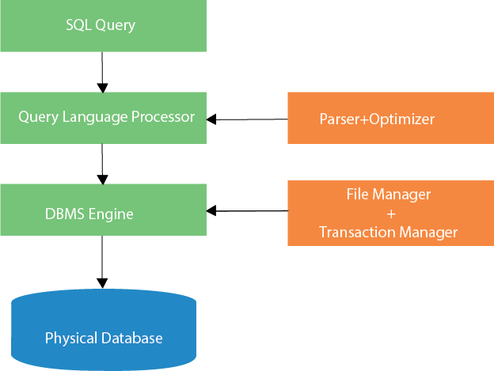
Overview of SQL
SQL Architecture –Following is a simple diagram showing the SQL Architecture −

Slide 10
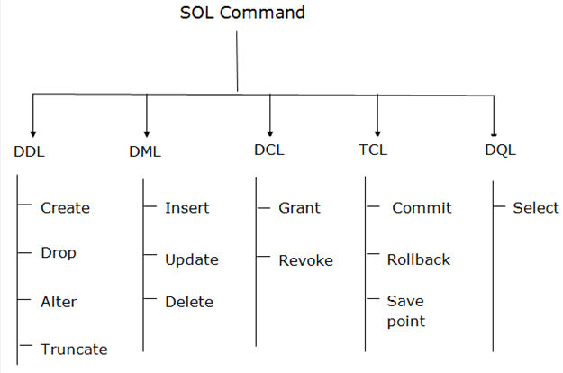
Types of Structured Query Language(SQL)
SQL is basically combination of four different languages, they are –

Slide 11
Types of Structured Query Language(SQL)
SQL is basically combination of four different languages, they are –
DDL (Data Definition Language)
DDL is used to define table schemas.
DML (Data Manipulation Language)
DML is used for inserting, updating and deleting data from the database.
DCL (Data Control Language)
DCL is used for user & permission management. It controls the access to the database.
TCL(Transaction Control Language )
TCL commands deals with the transaction within the database.
DQL (Data Query Language)
DQL is used to fetch the information from the database which is already stored there.

Slide 12
Types of Structured Query Language(SQL)
DDL(Data Definition Language) :
DDL or Data Definition Language actually consists of the SQL commands that can be used to define the database schema.
It simply deals with descriptions of the database schema and is used to create and modify the structure of database objects in the database.
DDL changes the structure of the table like creating a table, deleting a table, altering a table, etc.
All the command of DDL are auto-committed that means it permanently save all the changes in the database.

Slide 13
Types of Structured Query Language(SQL)
DDL(Data Definition Language) :
SQL uses the following set of DDL commands to define database schema −
  CREATE– is used to create the database or its objects (like table, index, function, views, store procedure and triggers).
  DROP – is used to delete objects from the database.
  ALTER-is used to alter the structure of the database.
  TRUNCATE–is used to remove all records from a table, including all spaces allocated for the records are removed.
  COMMIT –is used to add comments to the data dictionary.
  RENAME–is used to rename an object existing in the database.

Slide 14
Types of Structured Query Language(SQL)
DML(Data Manipulation Language) :
SQL commands that deals with the manipulation of data present in the database belong to DML or Data Manipulation Language and this includes most of the SQL statements.
DML commands are used to modify the database. It is responsible for all form of changes in the database.
DML commands are used for manipulating the data stored in the table and not the table itself.
The command of DML is not auto-committed that means it can't permanently save all the changes in the database. They can be rollback.

Slide 15
Types of Structured Query Language(SQL)
DML(Data Manipulation Language) :
SQL uses the following set of DML commands to define database schema −
  INSERT – is used to insert data into a table.
  UPDATE – is used to update existing data within a table.
  DELETE – is used to delete records from a database table.
  MERGE – is used to merging two rows or two tables

Slide 16
Types of Structured Query Language(SQL)
DQL (Data Query Language) :
DML statements are used for performing queries on the data within schema objects. The purpose of DQL Command is to get some schema relation based on the query passed to it.
Data query language is used to fetch data from tables based on conditions that we can easily apply.
DQL is used to fetch the data from the database.

Slide 17
Types of Structured Query Language(SQL)
DQL (Data Query Language) :
SQL uses the following set of DQL commands to define database schema −
  SELECT – is used to retrieve data from the a database
  This is the same as the projection operation of relational algebra. It is used to select the attribute based on the condition described by WHERE clause.

Slide 18
Types of Structured Query Language(SQL)
DCL(Data Control Language) :
DCL includes commands such as GRANT and REVOKE which mainly deals with the rights, permissions and other controls of the database system.
DCL commands are used to grant and take back authority from any database user.
Data control language are the commands to grant and take back authority from any database user.

Slide 19
Types of Structured Query Language(SQL)
DCL(Data Control Language) :
SQL uses the following set of DCL commands to define database schema −
  GRANT-gives user’s access privileges to database.
  REVOKE-withdraw user’s access privileges given by using the GRANT command.

Slide 20
Types of Structured Query Language(SQL)
TCL(Transaction Control Language)
TCL commands deals with the transaction within the database.
TCL commands can only use with DML commands like INSERT, DELETE and UPDATE only.
These operations are automatically committed in the database that's why they cannot be used while creating tables or dropping them.
These commands are to keep a check on other commands and their affect on the database.
These commands can annul changes made by other commands by rolling the data back to its original state. It can also make any temporary change permanent.

Slide 21
Types of Structured Query Language(SQL)
TCL(Transaction Control Language):
SQL uses the following set of TCL commands to define database schema −
  COMMIT– commits a Transaction.
  ROLLBACK– rollbacks a transaction in case of any error occurs.
  SAVEPOINT–sets a savepoint within a transaction.

Slide 22
Overview of SQL
What is a Query
A Query is a set of instruction given to the database management system, which tells RDBMS what information you would like to get from the database.
For e.g. to fetch the employee name from the database table EMPLOYEE, we write the SQL Query like this:
SELECT employee_name from EMPLOYEE;

Slide 23
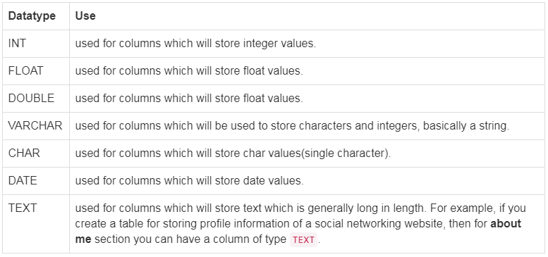
DDL(Data Definition Language) Commands
Most commonly used data types for Table columns

Slide 24
Types of Structured Query Language(SQL)
DDL(Data Definition Language) :
SQL uses the following set of DDL commands to define database schema −
  CREATE– is used to create the database or its objects (like table, index, function, views, store procedure and triggers).
  ALTER-is used to alter the structure of the database.
  TRUNCATE–is used to remove all records from a table, including all spaces allocated for the records are removed.
  DROP – is used to delete objects from the database.
  RENAME–is used to rename an object existing in the database.
  COMMIT –is used to add comments to the data dictionary.

Slide 25
DDL(Data Definition Language) Commands
SQL: create command
Creating a Database
To create a database in RDBMS, create command is used.
Following is the syntax,
CREATE DATABASE <DB_NAME>;
Example for creating Database
CREATE DATABASE Test;
The above command will create a database named Test, which will be an empty schema without any table.
To create tables in this newly created database, we can again use the create command.

Slide 26
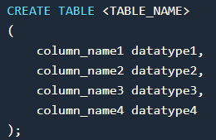
DDL(Data Definition Language) Commands
SQL: create command
create command can also be used to create tables. Now when we create a table, we have to specify the details of the columns of the tables too. We can specify the names and datatypes of various columns in the create command itself.
Following is the syntax,
create table command will tell the database system to create a new table with the given table name and column information.

Slide 27
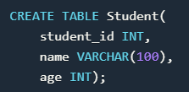
DDL(Data Definition Language) Commands
SQL: create command
Example for creating Table :
The above command will create a new table with name Student in the current database with 3 columns, namely student_id, name and age. Where the column student_id will only store integer, name will hold upto 100 characters and age will again store only integer value.

Slide 28
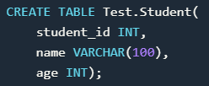
DDL(Data Definition Language) Commands
SQL: create command
If you are currently not logged into your database in which you want to create the table then you can also add the database name along with table name, using a dot operator .
For example, if we have a database with name Test and we want to create a table Student in it, then we can do so using the following query:
The above command will create a new table with name Student in the current database with 3 columns, namely student_id, name and age. Where the column student_id will only store integer, name will hold upto 100 characters and age will again store only integer value.

Slide 29
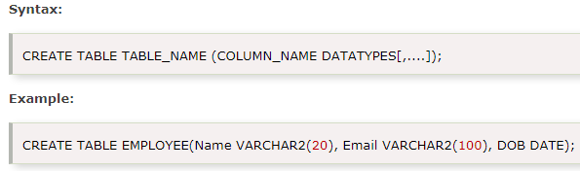
DDL(Data Definition Language) Commands
SQL: create command
CREATE It is used to create a new table in the database.

Slide 30
DDL(Data Definition Language) Commands
ALTER Command: Add a new Column
ALTER is used to alter the structure of the database.
Using ALTER command we can add a column to any existing table.
alter command is used for altering the table structure, such as,
to add a column to existing table
to rename any existing column
to change datatype of any column or to modify its size.
to drop a column from the table.
Following is the syntax,
ALTER TABLE table_name ADD( column_name datatype);

Slide 31

DDL(Data Definition Language) Commands
ALTER Command: Add a new Column
Here is an Example for this,
The above command will add a new column address to the table student, which will hold data of type varchar which is nothing but string, of length 200.

Slide 32


DDL(Data Definition Language) Commands
ALTER Command: Add multiple new Columns
Using ALTER command we can even add multiple new columns to any existing table.
Following is the syntax,.
Here is an Example for this,
The above command will add three new columns to the student table

Slide 33


DDL(Data Definition Language) Commands
ALTER Command: Rename a Column
Using ALTER command you can rename an existing column. Following is the syntax,
Following is the syntax,.
Here is an Example for this,
The above command will rename address column to location.

Slide 34
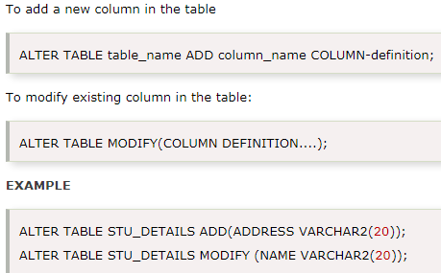
DDL(Data Definition Language) Commands
SQL: alter command
ALTER: It is used to alter the structure of the database.
This change could be either to modify the characteristics of an existing attribute or probably to add a new attribute.
Syntax :

Slide 35

DDL(Data Definition Language) Commands
SQL: TRUNCATE command
TRUNCATE command removes all the records from a table.
TRUNCATE: It is used to delete all the rows from the table and free the space containing the table.
But this command will not destroy the table's structure.
When we use TRUNCATE command on a table its (auto-increment) primary key is also initialized. Following is its syntax,
Following is the syntax,
;

Slide 36

DDL(Data Definition Language) Commands
SQL: TRUNCATE command
Example:
The above query will delete all the records from the table student.
In DML commands, we will study about the DELETE command which is also more or less same as the TRUNCATE command. We will also learn about the difference between the two in that tutorial.

Slide 37
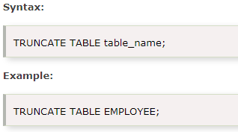
DDL(Data Definition Language) Commands
SQL: TRUNCATE command
TRUNCATE is used to delete all the rows from the table and free the space containing the table.

Slide 38
DDL(Data Definition Language) Commands
SQL: DROP command
DROP is used to delete both the structure and record stored in the table.
DROP command completely removes a table from the database.
This command will also destroy the table structure and the data stored in it.
Following is the syntax,
DROP TABLE table_name;

Slide 39
DDL(Data Definition Language) Commands
SQL: DROP command
Example :
DROP TABLE student;
The above query will delete the Student table completely. It can also be used on Databases, to delete the complete database. For example, to drop a database,
DROP DATABASE Test;
The above query will drop the database with name Test from the system.

Slide 40
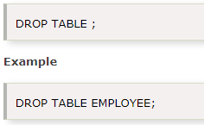
DDL(Data Definition Language) Commands
SQL: DROP command
DROP It is used to delete both the structure and record stored in the table.
Syntax

Slide 41
DDL(Data Definition Language) Commands
SQL: RENAME command
RENAME is used to rename an object existing in the database.
RENAME command is used to set a new name for any existing table.
Following is the syntax,
RENAME TABLE old_table_name to new_table_name
Example :
RENAME TABLE student to students_info;
The above query will rename the table student to students_info.

Slide 42
DDL(Data Definition Language) Commands
SQL: RENAME command
RENAME is used to rename an object existing in the database.
RENAME command is used to set a new name for any existing table.
Following is the syntax,
RENAME TABLE old_table_name to new_table_name
Example :
RENAME TABLE student to students_info;
The above query will rename the table student to students_info.

Slide 43
Types of Structured Query Language(SQL)
DML(Data Manipulation Language) :
SQL uses the following set of DML commands to define database schema −
  INSERT – is used to insert data into a table.
  UPDATE – is used to update existing data within a table.
  DELETE – is used to delete records from a database table.
  MERGE – is used to merging two rows or two tables

Slide 44
DML(Data Manipulation Language)
SQL: INSERT command
The INSERT statement is a SQL query. It is used to insert data into the row of a table.
Insert command is used to insert data into a table.
Following is its general syntax,
INSERT INTO table_name VALUES(data1, data2, ...)

Slide 45
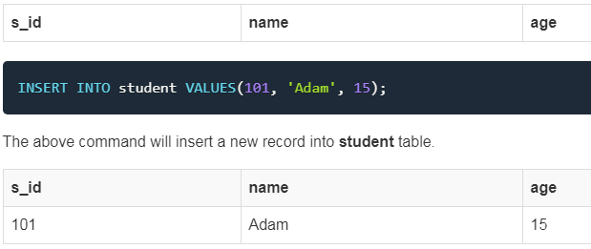
DML(Data Manipulation Language)
SQL: INSERT command
Example:
Consider a table student with the following fields.

Slide 46
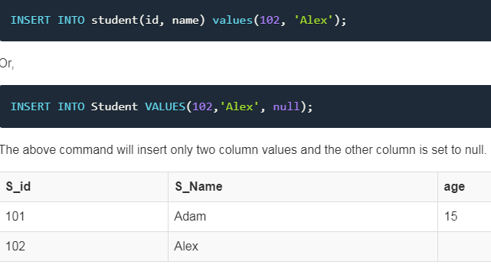
DML(Data Manipulation Language)
SQL: INSERT command
Insert NULL value to a column - Both the statements below
insert NULL valueinto age column of the student table.

Slide 47
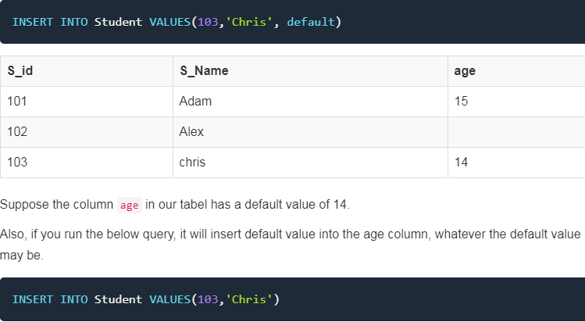
DML(Data Manipulation Language)
SQL: INSERT command
Insert Default value to a column

Slide 48
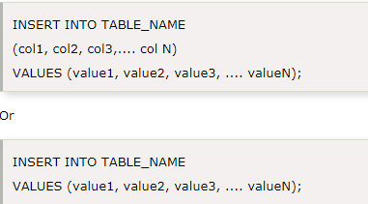
DML(Data Manipulation Language)
SQL: INSERT command
INSERT statement is a SQL query. It is used to insert data into the row of a table.
Syntax:
INSERT INTO EMP(Emp_ID, Dept) VALUES (A-101, “HR”)

Slide 49
DML(Data Manipulation Language)
SQL: UPDATE command
UPDATE command is used to update any record of data in a table.
Following is its general syntax,
UPDATE table_name SET column_name = new_value WHERE some_condition;
WHERE is used to add a condition to any SQL query, we will soon study about it in detail.
Example : Lets take a sample table student

Slide 50
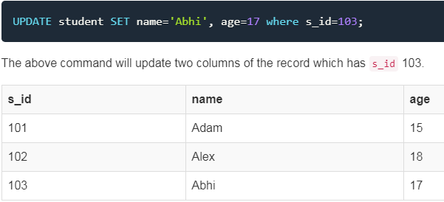
DML(Data Manipulation Language)
SQL: UPDATE command
Updating Multiple Columns
We can also update values of multiple columns using a single UPDATE statement.

Slide 51
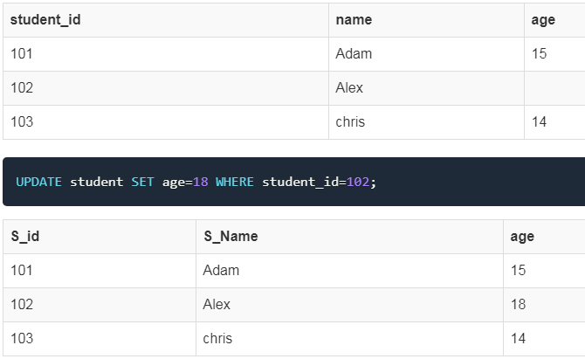
DML(Data Manipulation Language)
SQL: UPDATE command
In the above statement, if we do not use the WHERE clause, then our update query will update age for all the columns of the table to 18.

Slide 52
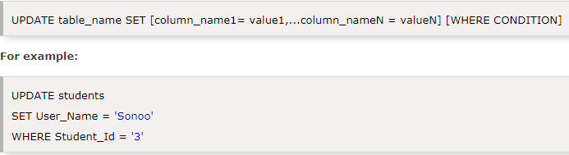
DML(Data Manipulation Language)
SQL: UPDATE command
UPDATE command is used to update or modify the value of a column in the table.
Syntax:

Slide 53
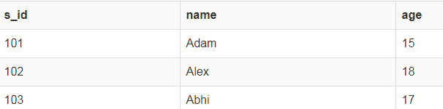
DML(Data Manipulation Language)
SQL: DELETE command
DELETE is used to removeDELETE command is used to delete data from a table.
Following is its general syntax: DELETE FROM table_name;
Let's take a sample table student:
Delete all Records from a Table
DELETE FROM student;
The above command will delete all the records from the table student.

Slide 54
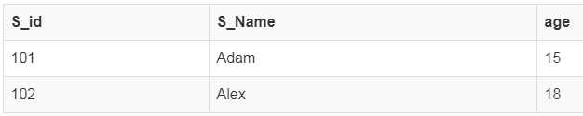
DML(Data Manipulation Language)
SQL: DELETE command
Delete a particular Record from a Table
In our student table if we want to delete a single record, we can use the WHERE clause to provide a condition in our DELETE statement.
DELETE FROM student WHERE s_id=103;
The above command will delete the record where s_id is 103 from the table student.

Slide 55
DML(Data Manipulation Language)
SQL: DELETE command
Isn't DELETE same as TRUNCATE
TRUNCATE command is different from DELETE command. The delete command will delete all the rows from a table whereas truncate command not only deletes all the records stored in the table, but it also re-initializes the table(like a newly created table).

Slide 56
DML(Data Manipulation Language)
SQL: DELETE command
Isn't DELETE same as TRUNCATE
For eg: If you have a table with 10 rows and an auto_increment primary key, and if you use DELETE command to delete all the rows, it will delete all the rows, but will not re-initialize the primary key, hence if you will insert any row after using the DELETE command, the auto_increment primary key will start from 11. But in case of TRUNCATE command, primary key is re-initialized, and it will again start from 1.

Slide 57
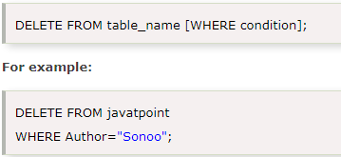
DML(Data Manipulation Language)
SQL: DELETE command
DELETE: It is used to remove one or more row from a table.
Syntax:

Slide 58
Types of Structured Query Language(SQL)
TCL(Transaction Control Language):
SQL uses the following set of TCL commands to define database schema −
Transaction Control Language(TCL) commands are used to manage transactions in the database. These are used to manage the changes made to the data in a table by DML statements. It also allows statements to be grouped together into logical transactions.
  COMMIT– commits a Transaction.
  ROLLBACK– rollbacks a transaction in case of any error occurs.
  SAVEPOINT–sets a savepoint within a transaction.

Slide 59
TCL(Transaction Control Language):
SQL: COMMIT command
COMMIT command is used to permanently save any transaction into the database.
When we use any DML command like INSERT, UPDATE or DELETE, the changes made by these commands are not permanent, until the current session is closed, the changes made by these commands can be rolled back.
To avoid that, we use the COMMIT command to mark the changes as permanent.
Following is commit command's syntax,
COMMIT;

Slide 60
TCL(Transaction Control Language):
SQL: COMMIT command
Commit: Commit command is used to save all the transactions to the database.
Syntax: COMMIT;
Example:
DELETE FROM CUSTOMERS
WHERE AGE = 25;
COMMIT;

Slide 61
TCL(Transaction Control Language):
SQL: ROLLBACK command
This command restores the database to last commited state. It is also used with SAVEPOINT command to jump to a savepoint in an ongoing transaction.
If we have used the UPDATE command to make some changes into the database, and realise that those changes were not required, then we can use the ROLLBACK command to rollback those changes, if they were not commited using the COMMIT command.
Following is rollback command's syntax,
ROLLBACK TO savepoint_name;

Slide 62
TCL(Transaction Control Language):
SQL: ROLLBACK command
Rollback: Rollback command is used to undo transactions that have not already been saved to the database.
Syntax: ROLLBACK;
Example:
DELETE FROM CUSTOMERS
WHERE AGE = 25;
ROLLBACK;

Slide 63
TCL(Transaction Control Language):
SQL: SAVEPOINT command
SAVEPOINT: It is used to roll the transaction back to a certain point without rolling back the entire transaction.
SAVEPOINT command is used to temporarily save a transaction so that you can rollback to that point whenever required.
Syntax -
SAVEPOINT savepoint_name;
In short, using this command we can name the different states of our data in any table and then rollback to that state using the ROLLBACK command whenever required.

Slide 64
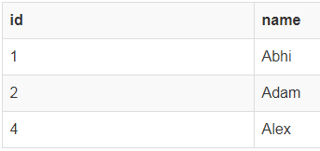
TCL(Transaction Control Language):
SQL: SAVEPOINT command
Using Savepoint and Rollback
Following is the table class,

Slide 65
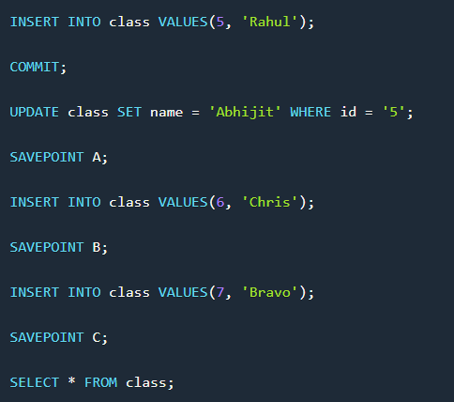
TCL(Transaction Control Language):
SQL: SAVEPOINT command
Lets use some SQL queries on the above table and see the results.

Slide 66
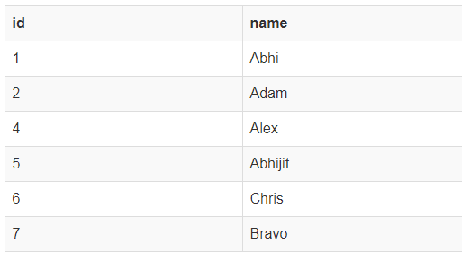
TCL(Transaction Control Language):
SQL: SAVEPOINT command
Lets use some SQL queries on the above table and see the results.
NOTE: SELECT statement is used to show the data stored in the table.
The resultant table will look like,

Slide 67
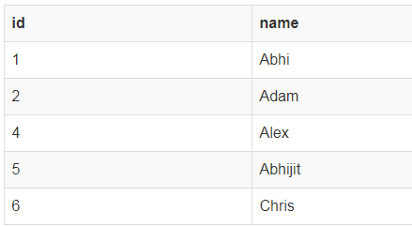
TCL(Transaction Control Language):
SQL: SAVEPOINT command
Now let's use the ROLLBACK command to roll back the state of data to the savepoint B.
ROLLBACK TO B;
SELECT * FROM class;
Now our class table will look like,

Slide 68
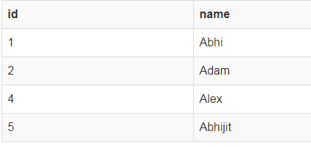
TCL(Transaction Control Language):
SQL: SAVEPOINT command
Now let's again use the ROLLBACK command to roll back the state of data to the savepoint A
ROLLBACK TO A;
SELECT * FROM class;
Now the table will look like,

Slide 69
Types of Structured Query Language(SQL)
DCL(Data Control Language) :
DCL includes commands such as GRANT and REVOKE which mainly deals with the rights, permissions and other controls of the database system.
DCL commands are used to grant and take back authority from any database user.
Data control language are the commands to grant and take back authority from any database user.

Slide 70
DCL(Data Control Language) :
Using GRANT and REVOKE
Data Control Language(DCL) is used to control privileges in Database. To perform any operation in the database, such as for creating tables, sequences or views, a user needs privileges. Privileges are of two types,
System: This includes permissions for creating session, table, etc and all types of other system privileges.
Object: This includes permissions for any command or query to perform any operation on the database tables

Slide 71
Types of Structured Query Language(SQL)
DCL(Data Control Language) :
In DCL we have two commands,
  GRANT- Used to provide any user access privileges or other priviliges for the database.
  REVOKE-withdraw user’s access privileges given by using the GRANT command.
  Used to take back permissions from any user.

Slide 72
Types of Structured Query Language(SQL)
DCL(Data Control Language) :
Allow a User to create session
When we create a user in SQL, it is not even allowed to login and create a session until and unless proper permissions/priviliges are granted to the user.
Following command can be used to grant the session creating priviliges.
GRANT CREATE SESSION TO username;

Slide 73
Types of Structured Query Language(SQL)
DCL(Data Control Language) :
Allow a User to create table
To allow a user to create tables in the database, we can use the below command,
GRANT CREATE TABLE TO username;

Slide 74
Types of Structured Query Language(SQL)
DCL(Data Control Language) :
Provide user with space on tablespace to store table
Allowing a user to create table is not enough to start storing data in that table. We also must provide the user with priviliges to use the available tablespace for their table and data.
ALTER USER username QUOTA UNLIMITED ON SYSTEM;
The above command will alter the user details and will provide it access to unlimited tablespace on system.

Slide 75
Types of Structured Query Language(SQL)
DCL(Data Control Language) :
Grant all privilege to a User
sysdba is a set of priviliges which has all the permissions in it. So if we want to provide all the privileges to any user, we can simply grant them the sysdba permission.
GRANT sysdba TO username;

Slide 76
Types of Structured Query Language(SQL)
DCL(Data Control Language) :
Grant permission to create any table
Sometimes user is restricted from creating come tables with names which are reserved for system tables. But we can grant privileges to a user to create any table using the below command,
GRANT CREATE ANY TABLE TO username;

Slide 77
Types of Structured Query Language(SQL)
DCL(Data Control Language) :
Grant permission to drop any table
As the title suggests, if you want to allow user to drop any table from the database, then grant this privilege to the user,
GRANT DROP ANY TABLE TO username;

Slide 78
Types of Structured Query Language(SQL)
DCL(Data Control Language) :
To take back Permissions
And, if you want to take back the privileges from any user, use the REVOKE command.
REVOKE CREATE TABLE FROM username

Slide 79
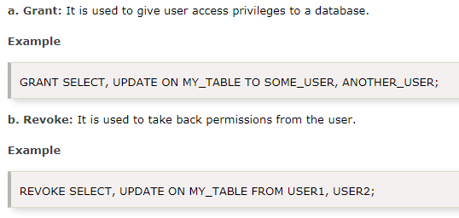
Types of Structured Query Language(SQL)
DCL(Data Control Language) :
DCL commands are used to grant and take back authority from any database user.

Slide 80
Types of Structured Query Language(SQL)
DQL (Data Query Language) :
DML statements are used for performing queries on the data within schema objects. The purpose of DQL Command is to get some schema relation based on the query passed to it.
Data query language is used to fetch data from tables based on conditions that we can easily apply.
DQL is used to fetch the data from the database.

Slide 81
Types of Structured Query Language(SQL)
DQL (Data Query Language) :
SQL uses the following set of DQL commands to define database schema −
WHERE clause is used to specify/apply any condition while retrieving, updating or deleting data from a table. This clause is used mostly with SELECT, UPDATE and DELETEquery.
When we specify a condition using the WHERE clause then the query executes only for those records for which the condition specified by the WHERE clause is true.
  SELECT – is used to retrieve data from the a database
  This is the same as the projection operation of relational algebra. It is used to select the attribute based on the condition described by WHERE clause.

Slide 82
Types of Structured Query Language(SQL)
DQL (Data Query Language) :
SQL uses the following set of DQL commands to define database schema −
  SELECT – is used to retrieve data from the a database
  This is the same as the projection operation of relational algebra. It is used to select the attribute based on the condition described by WHERE clause.

Slide 83
Types of Structured Query Language(SQL)
DQL (Data Query Language) :
SQL uses the following set of DQL commands to define database schema −
Syntax for WHERE clause
Here is how you can use the WHERE clause with a DELETE statement, or any other statement,
DELETE FROM table_name WHERE [condition];
The WHERE clause is used at the end of any SQL query, to specify a condition for execution.

Slide 84
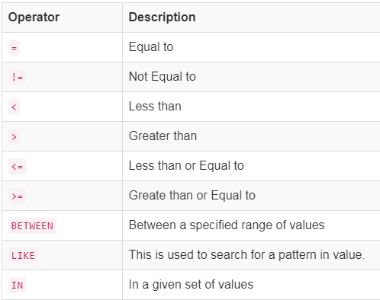
Types of Structured Query Language(SQL)
DQL (Data Query Language) :
Operators for WHERE clause condition

Slide 85
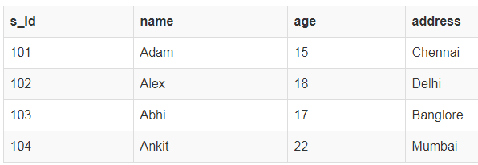
Types of Structured Query Language(SQL)
DQL (Data Query Language) :
SQL uses the following set of DQL commands to define database schema −
Time for an Example
Consider a table student,

Slide 86
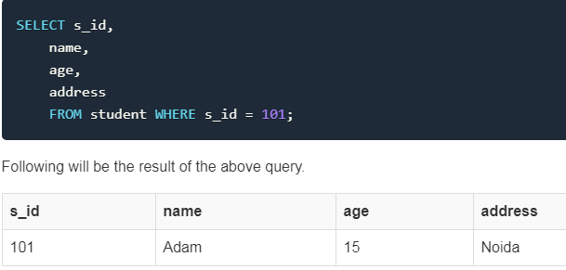
Types of Structured Query Language(SQL)
DQL (Data Query Language) :
SQL uses the following set of DQL commands to define database schema −
Now we will use the SELECT statement to display data of the table, based on a condition, which we will add to our SELECT query using WHERE clause.
Let's write a simple SQL query to display the record for student with s_id as 101.

Slide 87
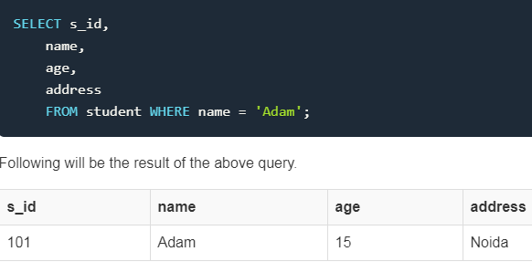
Types of Structured Query Language(SQL)
DQL (Data Query Language) :
SQL uses the following set of DQL commands to define database schema −
Applying condition on Text Fields
In the above example we have applied a condition to an integer value field, but what if we want to apply the condition on name field. In that case we must enclose the value in single quote ' '. Some databases even accept double quotes, but single quotes is accepted by all.

Slide 88
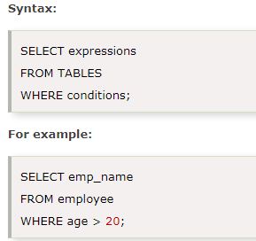
Types of Structured Query Language(SQL)
DQL (Data Query Language) :
SQL uses the following set of DQL commands to define database schema −
SELECT is the same as the projection operation of relational algebra. It is used to select the attribute based on the condition described by WHERE clause.

Slide 89
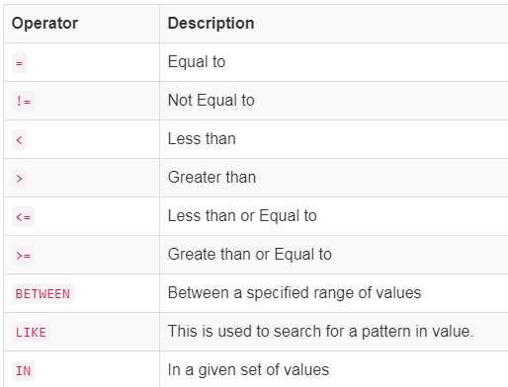
Structured Query Language(SQL)
SQL Comparison Operators:
Following is a list of operators that can be used while specifying the WHERE clause condition.

Slide 90
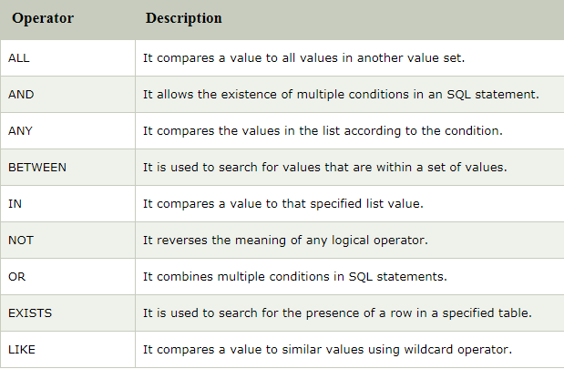
Structured Query Language(SQL)
SQL Logical Operators

Slide 91
Structured Query Language(SQL)
SQL Logical Operators

Slide 92
Structured Query Language(SQL)
Using the WHERE SQL clause
WHERE clause is used to specify/apply any condition while retrieving, updating or deleting data from a table. This clause is used mostly -
with SELECT, UPDATE and DELETEquery
When we specify a condition using the WHERE clause then the query executes only for those records for which the condition specified by the WHERE clause is true.

Slide 93
Structured Query Language(SQL)
Using the WHERE SQL clause
Syntax for WHERE clause
Here is how you can use the WHERE clause with a DELETE statement, or any other statement,
DELETE FROM table_name WHERE [condition];
The WHERE clause is used at the end of any SQL query, to specify a condition for execution.

Slide 94
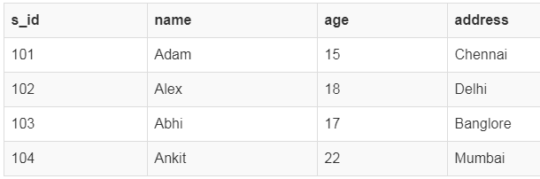
Structured Query Language(SQL)
Using the WHERE SQL clause
Time for an Example :
Consider a table student,
Now we will use the SELECT statement to display data of the table, based on a condition, which we will add to our SELECT query using WHERE clause.

Slide 95
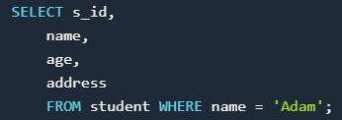

Structured Query Language(SQL)
Using the WHERE SQL clause
Applying condition on Text Fields
In the above example we have applied a condition to an integer value field, but what if we want to apply the condition on name field. In that case we must enclose the value in single quote ' '. Some databases even accept double quotes, but single quotes is accepted by all.
Following will be the result of the above query.

Slide 96
Structured Query Language(SQL)
SQL Create Table -
SQL create table is used to create a table in the database. To define the table, you should define the name of the table and also define its columns and column's data type.
Syntax
create table "table_name" ("column1" "data type", "column2" "data type", "column3" "data type", ... "columnN" "data type");
Example
SQL> CREATE TABLE EMPLOYEE ( EMP_ID INT NOT NULL,
EMP_NAME VARCHAR (25) NOT NULL,
PHONE_NO INT NOT NULL,
ADDRESS CHAR (30),
PRIMARY KEY (ID)
);

Slide 97
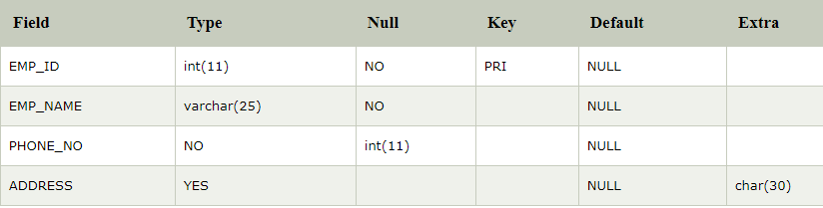
Structured Query Language(SQL)
SQL Create Table -
If you create the table successfully, you can verify the table by looking at the message by the SQL server. Else you can use DESC command as follows:
SQL> DESC EMPLOYEE;

Slide 98
Structured Query Language(SQL)
SQL DELETE table
In SQL, DELETE statement is used to delete rows from a table. We can use WHERE condition to delete a specific row from a table. If you want to delete all the records from the table, then you don't need to use the WHERE clause.
Syntax
DELETE FROM table_name WHERE condition;

Slide 99
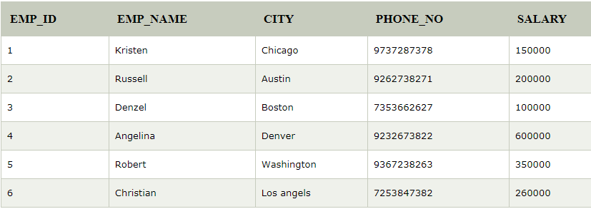
Structured Query Language(SQL)
SQL DELETE table
Suppose, the EMPLOYEE table having the following records:

Slide 100
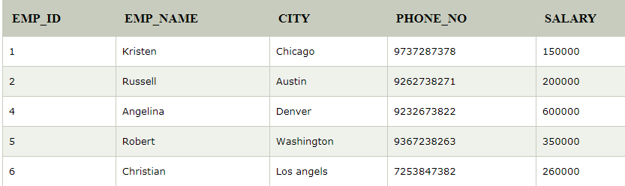
Structured Query Language(SQL)
SQL DELETE table
The following query will DELETE an employee whose ID is 3
.
SQL> DELETE FROM EMPLOYEE
WHERE EMP_ID = 3;
Now, the EMPLOYEE table would have the following records.

Slide 101
Structured Query Language(SQL)
SQL DELETE table
If you don't specify the WHERE condition, it will remove all the rows from the table.
DELETE FROM EMPLOYEE;
Now, the EMPLOYEE table would not have any records.

Slide 102
Structured Query Language(SQL)
SQL SELECT Statement
In SQL, the SELECT statement is used to query or retrieve data from a table in the database. The returns data is stored in a table, and the result table is known as result-set.
Syntax
SELECT column1, column2, ...
FROM table_name;
Here, the expression is the field name of the table that you want to select data from.
Use the following syntax to select all the fields available in the table:
SELECT * FROM table_name;

Slide 103
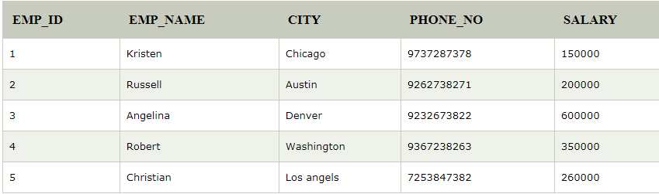
Structured Query Language(SQL)
SQL SELECT Statement

Slide 104
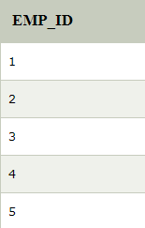
Structured Query Language(SQL)
SQL SELECT Statement
To fetch the EMP_ID of all the employees, use the following query:
SELECT EMP_ID FROM EMPLOYEE;
Output

Slide 105
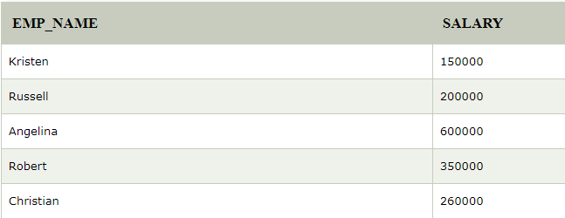
Structured Query Language(SQL)
SQL SELECT Statement
To fetch the EMP_NAME and SALARY, use the following query:
SELECT EMP_NAME, SALARY FROM EMPLOYEE;
Output

Slide 106
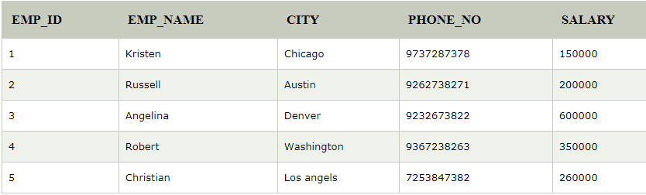
Structured Query Language(SQL)
SQL SELECT Statement
To fetch all the fields from the EMPLOYEE table, use the following query:
SELECT * FROM EMPLOYEE
Output

Slide 107
Structured Query Language(SQL)
SQL Group By Clause
Group by clause is used to group the results of a SELECT query based on one or more columns. It is also used with SQL functions to group the result from one or more tables.
Syntax for using Group by in a statement-
SELECT column_name, function(column_name)
FROM table_name
WHERE condition
GROUP BY column_name;

Slide 108
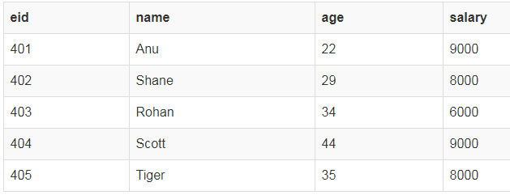
Structured Query Language(SQL)
SQL Group By Clause
Example of Group by in a Statement
Consider the following Emp table

Slide 109
Structured Query Language(SQL)
SQL Group By Clause
Example of Group by in a Statement
Consider the following Emp table
Here we want to find name and age of employees grouped by their salaries or in other words, we will be grouping employees based on their salaries, hence, as a result, we will get a data set, with unique salaries listed, along side the first employee's name and age to have that salary. Hope you are getting the point here
group by is used to group different row of data together based on any one column.

Slide 110
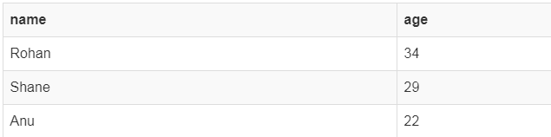
Structured Query Language(SQL)
SQL Group By Clause
SQL query for the above requirement will be,
SELECT name, age FROM Emp GROUP BY salary
Result will be,

Slide 111
Structured Query Language(SQL)
SQL Group By Clause
Example of Group by in a Statement with WHERE clause
Consider the following Emp table

Slide 112
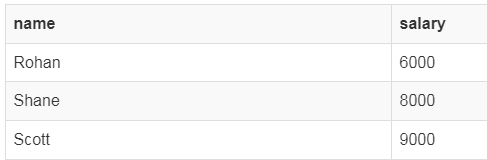
Structured Query Language(SQL)
SQL Group By Clause
SQL query will be,
SELECT name, salary FROM Emp WHERE age > 25 GROUP BY salary;
Result will be-
Group By clause will always come at the end of the SQL query, just like the Order by clause.

Slide 113
Structured Query Language(SQL)
Views in SQL :
Views in SQL are considered as a virtual table. A view also contains rows and columns.
To create the view, we can select the fields from one or more tables present in the database.
A view can either have specific rows based on certain condition or all the rows of a table.

Slide 114
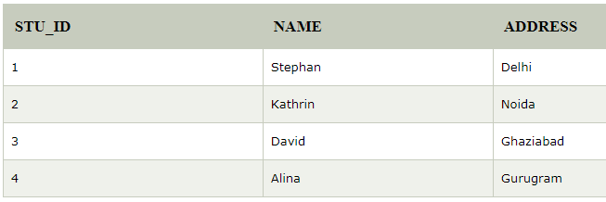
Structured Query Language(SQL)
Views in SQL :
Sample table:
Student_Detail

Slide 115
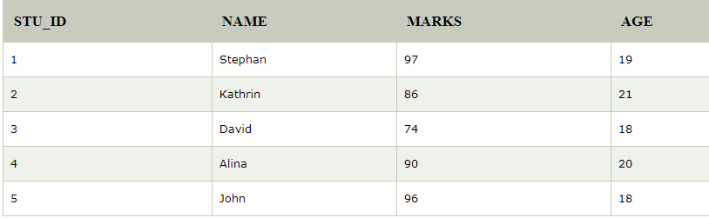
Structured Query Language(SQL)
Views in SQL :
Sample table:
Student_Marks

Slide 116
Structured Query Language(SQL)
Views in SQL :
1. Creating view -
A view can be created using the CREATE VIEW statement. We can create a view from a single table or multiple tables.
Syntax:
CREATE VIEW view_name AS
SELECT column1, column2.....
FROM table_name
WHERE condition;

Slide 117
Structured Query Language(SQL)
Views in SQL :
2. Creating View from a single table
In this example, we create a View named DetailsView from the table Student_Detail.
Query:
CREATE VIEW DetailsView AS
SELECT NAME, ADDRESS
FROM Student_Details
WHERE STU_ID < 4;
Just like table query, we can query the view to view the data.

Slide 118
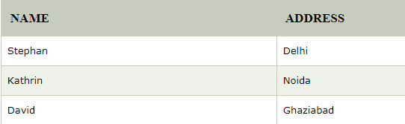
Structured Query Language(SQL)
Views in SQL :
Just like table query, we can query the view to view the data.
SELECT * FROM DetailsView;
Output:

Slide 119
Structured Query Language(SQL)
Views in SQL :
3. Creating View from multiple tables
View from multiple tables can be created by simply include multiple tables in the SELECT statement.
In the given example, a view is created named MarksView from two tables Student_Detail and Student_Marks.

Slide 120
Structured Query Language(SQL)
Views in SQL :
Query:
CREATE VIEW MarksView AS
SELECT Student_Detail.NAME, Student_Detail.ADDRESS, Student_Marks.MARKS
FROM Student_Detail, Student_Mark
WHERE Student_Detail.NAME = Student_Marks.NAME;

Slide 121
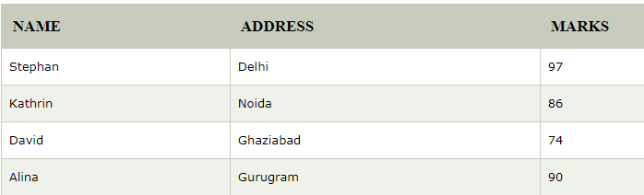
Structured Query Language(SQL)
Views in SQL :
To display data of View MarksView:
SELECT * FROM MarksView;

Slide 122
Structured Query Language(SQL)
Views in SQL :
4. Deleting View
A view can be deleted using the Drop View statement.
Syntax
DROP VIEW view_name;
Example:
If we want to delete the View MarksView, we can do this as:
DROP VIEW MarksView;

Slide 123
Structured Query Language(SQL)
Where clause in SQL :
The SQL WHERE clause is used to specify a condition while fetching the data from a single table or by joining with multiple tables. If the given condition is satisfied, then only it returns a specific value from the table. You should use the WHERE clause to filter the records and fetching only the necessary records.
The WHERE clause is not only used in the SELECT statement, but it is also used in the UPDATE, DELETE statement, etc., which we would examine in the subsequent chapters.

Slide 124
Structured Query Language(SQL)
Where clause in SQL :
Syntax :
The basic syntax of the SELECT statement with the WHERE clause is as shown below.
SELECT column1, column2, columnN
FROM table_name
WHERE [condition] ;
You can specify a condition using the comparison or logical operators like >, <, =, LIKE, NOT, etc.

Slide 125
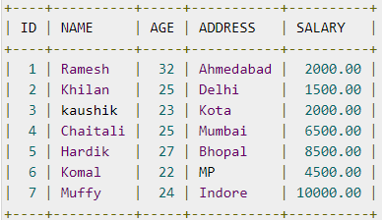
Structured Query Language(SQL)
Where clause in SQL :
Example -
Consider the CUSTOMERS table having the following records −

Slide 126

Structured Query Language(SQL)
Where clause in SQL :
The following code is an example which would fetch the ID, Name and Salary fields from the CUSTOMERS table, where the salary is greater than 2000 −
SQL> SELECT ID, NAME, SALARY
FROM CUSTOMERS
WHERE SALARY > 2000;
This would produce the following result −

Slide 127

Structured Query Language(SQL)
Where clause in SQL :
The following query is an example, which would fetch the ID, Name and Salary fields from the CUSTOMERS table for a customer with the name Hardik.
Here, it is important to note that all the strings should be given inside single quotes (''). Whereas, numeric values should be given without any quote as in the above example.
SQL> SELECT ID, NAME, SALARY
FROM CUSTOMERS
WHERE NAME = 'Hardik';
This would produce the following result −

Slide 128

Structured Query Language(SQL)
Where clause in SQL :
We have a table EMPLOYEES:
Lets say we want to fetch the name of the those employees who are more than 23 years old. The SQL statement would look like this –

Slide 129


Structured Query Language(SQL)
Where clause in SQL :
Query –
SELECT EMP_NAME
FROM EMPLOYEES
WHERE EMP_AGE > 23;
Result:

Slide 130
Structured Query Language(SQL)
Where clause in SQL :
Fetch all the details of employees having salary greater than 6000.
Query:
SELECT * FROM EMPLOYEES
WHERE EMP_SALARY > 6000;
Result:

Slide 131
Structured Query Language(SQL)
Where clause in SQL :
Text Field in Where clause condition
In the above examples, we have seen that when the condition required numeric values in conditions such as employee salary & employee age, we didn’t require the quotes.
However when the condition involves a column that has text value then in such case we have to enclose the value in single quotes. Lets take an example to understand this.

Slide 132

Structured Query Language(SQL)
Where clause in SQL :
Text Field in Where clause condition
Lets say I want to find out the SSN of employee “Ajeet”. I can do it like this:
Query:
SELECT SSN, EMP_NAME
FROM EMPLOYEES .
WHERE EMP_NAME = 'Ajeet‘;
Result:

Slide 133
Structured Query Language(SQL)
SQL WHERE Clause with Examples - AND, OR, IN, NOT IN
The SQL AND & OR operators are used to combine multiple conditions to narrow data in an SQL statement. These two operators are called as the conjunctive operators.
These operators provide a means to make multiple comparisons with different operators in the same SQL statement.

Slide 134
Structured Query Language(SQL)
The AND Operator -
The AND operator allows the existence of multiple conditions in an SQL statement's WHERE clause.
Syntax
The basic syntax of the AND operator with a WHERE clause is as follows −
SELECT column1, column2, columnN FROM table_name WHERE [condition1] AND [condition2]...AND [conditionN];
You can combine N number of conditions using the AND operator. For an action to be taken by the SQL statement, whether it be a transaction or a query, all conditions separated by the AND must be TRUE.

Slide 135

Structured Query Language(SQL)
The AND Operator -
Example -
Consider the CUSTOMERS table having the following records −

Slide 136

Structured Query Language(SQL)
The AND Operator -
Example –
Following is an example, which would fetch the ID, Name and Salary fields from the CUSTOMERS table, where the salary is greater than 2000 and the age is less than 25 years −
SQL> SELECT ID, NAME, SALARY
FROM CUSTOMERS
WHERE SALARY > 2000 AND age < 25;
This would produce the following result −

Slide 137
Structured Query Language(SQL)
The OR Operator :
The OR operator is used to combine multiple conditions in an SQL statement's WHERE clause.
Syntax -
The basic syntax of the OR operator with a WHERE clause is as follows −
SELECT column1, column2, columnN
FROM table_name
WHERE [condition1] OR [condition2]...OR [conditionN] ;

Slide 138

Structured Query Language(SQL)
The OR Operator :
You can combine N number of conditions using the OR operator. For an action to be taken by the SQL statement, whether it be a transaction or query, the only any ONE of the conditions separated by the OR must be TRUE.
Example
Consider the CUSTOMERS table having the following records −

Slide 139

Structured Query Language(SQL)
The OR Operator :
The following code block hasa query, which would fetch the ID, Name and Salary fields from the CUSTOMERS table, where the salary is greater than 2000 OR the age is less than 25 years.
SQL> SELECT ID, NAME, SALARY
FROM CUSTOMERS
WHERE SALARY > 2000 OR age < 25;
This would produce the following result -

Slide 140
Structured Query Language(SQL)
Where clause in SQL :
Operators allowed in The WHERE Clause conditions
In the above examples we have seen that where clause allowed operators as > & =. Lets see the complete list of operators that we can use in the where clause.

Slide 141

Structured Query Language(SQL)
Operators allowed in The WHERE Clause conditions
SQL where clause with multiple conditions
Lets take the same table:

Slide 142

Structured Query Language(SQL)
Operators allowed in The WHERE Clause conditions
SQL where clause with multiple conditions
Lets fetch the employee details where employee age is greater than 23 and salary is greater than 5000. For such query we have to use multiple conditions in where clause.
Query:
SELECT * FROM EMPLOYEES WHERE EMP_SALARY > 5000 AND EMP_AGE > 23;
Result:

Slide 143

Structured Query Language(SQL)
Operators allowed in The WHERE Clause conditions
Another multiple conditions example: Fetch the employee names, where either employee age is less than 20 or salary is less than 5000.
Query:
SELECT EMP_NAME
FROM EMPLOYEES
WHERE EMP_SALARY < 5000 OR EMP_AGE < 20;
Result:

Slide 144

Structured Query Language(SQL)
SQL AND Example
Table: STUDENT
Lets write an SQL statements to fetch the name of the students where student age is “greater than 23” and address is “Delhi”

Slide 145

Structured Query Language(SQL)
SQL AND Example
Query:
SELECT STU_NAME
FROM STUDENT
WHERE AGE > 23 AND ADDRESS = 'Delhi‘;
Result:

Slide 146

Structured Query Language(SQL)
SQL OR Example
Table: EMPLOYEE
Lets write an SQL statements to fetch the details of the employees, where either employee age is “greater than 30” or address is “Agra”.

Slide 147

Structured Query Language(SQL)
SQL OR Example
Query:
SELECT * FROM EMPLOYEE
WHERE AGE > 30 OR ADDRESS = 'Agra';
Result:

Slide 148
Structured Query Language(SQL)
SQL OR Example
Query:
SELECT * FROM EMPLOYEE
WHERE AGE > 30 OR ADDRESS = 'Agra';
Result:
- Row number 1 is in the output because it meets the second condition (ADDRESS = ‘Agra’).
- Row number 2nd and 4th are in the output because they meet the first condition (AGE > 30).
- Row number 5th is in the output because it meets both the conditions.

Slide 149
Structured Query Language(SQL)
SQL NOT Operator :
When a NOT operator is used with a condition, only those rows will fetched from database which do not meet the given condition.
NOT Operator Syntax –
SELECT column_name1, column_name2, ...
FROM table_name
WHERE NOT condition;

Slide 150

Structured Query Language(SQL)
SQL NOT Operator :

Slide 151

Structured Query Language(SQL)
SQL NOT Operator :
The following SQL statement selects all the order id and customer name where address is NOT Sector121.
Query:
SELECT ID, CUSTOMER_NAME FROM ORDER
WHERE NOT ADDRESS = 'Sector121';
Result:

Slide 152

Structured Query Language(SQL)
SQL AND, OR and NOT Operators together
We can use AND, OR and NOT logical operators together in where clause.
Table: EMPLOYEE

Slide 153

Structured Query Language(SQL)
SQL AND, OR and NOT Operators together
The following SQL statement will fetch the details of those employees, who are more than 40 years old and their location is either “Chennai” or “Agra”.
SELECT * FROM EMPLOYEE WHERE AGE>40 AND (LOCATION='Chennai' OR LOCATION='Agra');
Result:

Slide 154

Structured Query Language(SQL)
SQL AND, OR and NOT Operators together
Lets see an example where we are using all three AND, OR and NOT operators in a single SQL statement.
Table: EMPLOYEE

Slide 155

Structured Query Language(SQL)
SQL AND, OR and NOT Operators together
The following SQL statement will fetch the details of those employees, who are more than 40 years old and their location is either “Chennai” or NOT “Agra”.
SELECT * FROM EMPLOYEE WHERE AGE>40 AND (LOCATION='Chennai' OR NOT LOCATION='Agra');
Result:

Slide 156
Structured Query Language(SQL)
SQL ORDER BY Clause :
SQL SELECT Statement returns the rows in no particular order. With the help of ORDER BY clause, we can order the rows in a desired order. ORDER BY clause is used to sort the returned records in an order. By using ORDER BY clause, we can sort the result in ascending or descending order. This clause can be used with multiple columns as well.
ORDER BY Syntax -
SELECT column_name1, column_name2, column_name3....
FROM table_name
WHERE Condition
ORDER BY column_name1, column_name2, .... (ASC OR DESC);
Here ASC is used for sorting in ascending order and DESC for descending order.

Slide 157
Structured Query Language(SQL)
SQL: ORDER BY Clause
This SQL tutorial explains how to use the SQL ORDER BY clause with syntax and examples.
Description
The SQL ORDER BY clause is used to sort the records in the result set for a SELECT statement.
Syntax
The syntax for the ORDER BY clause in SQL is:
SELECT expressions FROM tables [WHERE conditions] ORDER BY expression [ ASC | DESC ];

Slide 158

Structured Query Language(SQL)
SQL ORDER BY clause example -
Lets say we have a table “STUDENT” with the following records.

Slide 159
Structured Query Language(SQL)
SQL ORDER BY clause example -
The following SQL statement will fetch all the records from the table “STUDENT” and the returned rows will be in ascending order of student age.
SELECT * FROM STUDENT ORDER BY AGE;
Note: The default order of sorting is ascending so the rows will be sorted based on the column “AGE”, even though we have not used the ASC keyword in order by clause. So it is safe to say that the following query is same as the above query and would fetch the same result.

Slide 160

Structured Query Language(SQL)
SQL ORDER BY clause example -
SELECT * FROM STUDENT
ORDER BY AGE ASC;
Result:

Slide 161

Structured Query Language(SQL)
SQL ORDER BY DESC example
Table: STUDENT

Slide 162

Structured Query Language(SQL)
The following SQL statement will fetch the student names from the table “STUDENT” and the returned names will be sorted in descending order (we have used DESC for descending order in the ORDER BY clause).
SELECT NAME
FROM STUDENT ORDER BY NAME DESC;
Result:
A list of student names sorted in the descending order.

Slide 163

Structured Query Language(SQL)
SQL: ORDER BY Clause
Example - Sorting Results in Ascending Order
To sort your results in ascending order, you can specify the ASC attribute. If no value (ASC or DESC) is provided after a field in the ORDER BY clause, the sort order will default to ascending order. Let's explore this further.
In this example, we have a table called customers with the following data:

Slide 164

Structured Query Language(SQL)
SQL: ORDER BY Clause
Enter the following SQL statement:
SELECT * FROM customers ORDER BY last_name;
There will be 6 records selected. These are the results that you should see:

Slide 165
Structured Query Language(SQL)
SQL: ORDER BY Clause
This example would return all records from the customers sorted by the last_name field in ascending order and would be equivalent to the following SQL ORDER BY clause:
SELECT * FROM customers
ORDER BY last_name ASC;
Most programmers omit the ASC attribute if sorting in ascending order.

Slide 166

Structured Query Language(SQL)
SQL: ORDER BY Clause
Example - Sorting Results in descending order
When sorting your result set in descending order, you use the DESC attribute in your ORDER BY clause.
In this example, we have a table called suppliers with the following data:

Slide 167

Structured Query Language(SQL)
SQL: ORDER BY Clause
Enter the following SQL statement:
SELECT * FROM suppliers WHERE supplier_id > 400 ORDER BY supplier_id DESC;
There will be 5 records selected.
Results :
This example would sort the result set by the supplier_id field in descending order.

Slide 168
Structured Query Language(SQL)
SQL Sub Query
A Subquery is a query within another SQL query and embedded within the WHERE clause.
Important Rule:
A subquery can be placed in a number of SQL clauses like WHERE clause, FROM clause, HAVING clause.
You can use Subquery with SELECT, UPDATE, INSERT, DELETE statements along with the operators like =, <, >, >=, <=, IN, BETWEEN, etc.
A subquery is a query within another query. The outer query is known as the main query, and the inner query is known as a subquery.
Subqueries are on the right side of the comparison operator.
A subquery is enclosed in parentheses.
In the Subquery, ORDER BY command cannot be used. But GROUP BY command can be used to perform the same function as ORDER BY command.

Slide 169
Structured Query Language(SQL)
SQL Sub Query
Subqueries with the Select Statement
SQL subqueries are most frequently used with the Select statement.
Syntax
SELECT column_name
FROM table_name
WHERE column_name expression operator
( SELECT column_name from table_name WHERE ... );

Slide 170

Structured Query Language(SQL)
SQL Sub Query
Example
Consider the EMPLOYEE table have the following records:

Slide 171

Structured Query Language(SQL)
SQL Sub Query
The subquery with a SELECT statement will be:
SELECT *FROM EMPLOYEE
WHERE ID IN (SELECT ID
FROM EMPLOYEE
WHERE SALARY > 4500);
This would produce the following result:

Slide 172
Structured Query Language(SQL)
2. Subqueries with the INSERT Statement
SQL subquery can also be used with the Insert statement. In the insert statement, data returned from the subquery is used to insert into another table.
In the subquery, the selected data can be modified with any of the character, date functions.
Syntax:
INSERT INTO table_name (column1, column2, column3....)
SELECT *
FROM table_name
WHERE VALUE OPERATOR

Slide 173
Structured Query Language(SQL)
Example
Consider a table EMPLOYEE_BKP with similar as EMPLOYEE.
Now use the following syntax to copy the complete EMPLOYEE table into the EMPLOYEE_BKP table.
INSERT INTO EMPLOYEE_BKP
SELECT * FROM EMPLOYEE
WHERE ID IN (SELECT ID
FROM EMPLOYEE);

Slide 174
Structured Query Language(SQL)
3. Subqueries with the UPDATE Statement
The subquery of SQL can be used in conjunction with the Update statement. When a subquery is used with the Update statement, then either single or multiple columns in a table can be updated.
Syntax
UPDATE table
SET column_name = new_value
WHERE VALUE OPERATOR
(SELECT COLUMN_NAME
FROM TABLE_NAME
WHERE condition);

Slide 175
Structured Query Language(SQL)
Example
Let's assume we have an EMPLOYEE_BKP table available which is backup of EMPLOYEE table. The given example updates the SALARY by .25 times in the EMPLOYEE table for all employee whose AGE is greater than or equal to 29.
UPDATE EMPLOYEE
SET SALARY = SALARY * 0.25
WHERE AGE IN (SELECT AGE FROM CUSTOMERS_BKP
WHERE AGE >= 29);

Slide 176

Structured Query Language(SQL)
This would impact three rows, and finally, the EMPLOYEE table would have the following records.

Slide 177
Structured Query Language(SQL)
4. Subqueries with the DELETE Statement
The subquery of SQL can be used in conjunction with the Delete statement just like any other statements mentioned above.
Syntax
DELETE FROM TABLE_NAME
WHERE VALUE OPERATOR
(SELECT COLUMN_NAME
FROM TABLE_NAME
WHERE condition);

Slide 178
Structured Query Language(SQL)
4. Subqueries with the DELETE Statement
Example -
Let's assume we have an EMPLOYEE_BKP table available which is backup of EMPLOYEE table. The given example deletes the records from the EMPLOYEE table for all EMPLOYEE whose AGE is greater than or equal to 29.
DELETE FROM EMPLOYEE
WHERE AGE IN (SELECT AGE FROM EMPLOYEE_BKP
WHERE AGE >= 29 );

Slide 179

Structured Query Language(SQL)
This would impact three rows, and finally, the EMPLOYEE table would have the following records.

Slide 180
Structured Query Language(SQL)
DISTINCT keyword
The distinct keyword is used with SELECT statement to retrieve unique values from the table. Distinct removes all the duplicate records while retrieving records from any table in the database.
Syntax for DISTINCT Keyword -
SELECT DISTINCT column-name FROM table-name;

Slide 181
Structured Query Language(SQL)
DISTINCT keyword
Example using DISTINCT Keyword –
Consider the following Emp table. As you can see in the table below, there is employee name, along with employee salary and age.
In the table below, multiple employees have the same salary, so we will be using DISTINCT keyword to list down distinct salary amount, that is currently being paid to the employees.

Slide 182

Structured Query Language(SQL)
DISTINCT keyword
SELECT DISTINCT salary FROM Emp;

Slide 183

Structured Query Language(SQL)
DISTINCT keyword
The above query will return only the unique salary from Emp table.

Slide 184
Structured Query Language(SQL)
SQL - UPDATE Query
The SQL UPDATE Query is used to modify the existing records in a table. You can use the WHERE clause with the UPDATE query to update the selected rows, otherwise all the rows would be affected.
Syntax
The basic syntax of the UPDATE query with a WHERE clause is as follows −
UPDATE table_name SET column1 = value1, column2 = value2...., columnN = valueN WHERE [condition];

Slide 185

Structured Query Language(SQL)
SQL - UPDATE Query
Example
Consider the CUSTOMERS table having the following records −

Slide 186
Structured Query Language(SQL)
SQL - UPDATE Query
The following query will update the ADDRESS for a customer whose ID number is 6 in the table.
SQL> UPDATE CUSTOMERS SET ADDRESS = 'Pune' WHERE ID = 6;

Slide 187

Structured Query Language(SQL)
SQL - UPDATE Query
Now, the CUSTOMERS table would have the following records −

Slide 188
Structured Query Language(SQL)
SQL - UPDATE Query
If you want to modify all the ADDRESS and the SALARY column values in the CUSTOMERS table, you do not need to use the WHERE clause as the UPDATE query would be enough as shown in the following code block.
SQL> UPDATE CUSTOMERS SET ADDRESS = 'Pune', SALARY = 1000.00;Now,
CUSTOMERS table would have the following records −

Slide 189

Structured Query Language(SQL)
SQL - UPDATE Query
CUSTOMERS table would have the following records −

Slide 190
Structured Query Language(SQL)
Schema:-
create table employee(empid int primary key,empname varchar(100), department varchar(50),contactno bigint, emaildid varchar(100), empheadid int)
create table empproject(empid int foreign key references employee(empid), projectid varchar(50) foreign key references project(projectid), clientid varchar(50) foreign key references clienttable(clientid),startyear int, endyear int)

Slide 191
Structured Query Language(SQL)
Aggregate functions in SQL :
In database management an aggregate function is a function where the values of multiple rows are grouped together as input on certain criteria to form a single value of more significant meaning.
An aggregate function allows you to perform a calculation on a set of values to return a single scalar value. We often use aggregate functions with the GROUP BY and HAVING clauses of the SELECT statement.
Various Aggregate Functions
1)Count() 2) Sum() 3) Avg()
4) Min() 5) Max()

Slide 192
Structured Query Language(SQL)
Aggregate functions in SQL :
The following are the most commonly used SQL aggregate functions:
AVG – calculates the average of a set of values.
COUNT – counts rows in a specified table or view.
MIN – gets the minimum value in a set of values.
MAX – gets the maximum value in a set of values.
SUM – calculates the sum of values.
All aggregate functions above ignore NULL values except for the COUNT function.

Slide 193

Structured Query Language(SQL)
Examples of Aggregate functions :

Slide 194

Structured Query Language(SQL)
Aggregate functions in SQL :
Now let us understand each Aggregate function with a example:

Slide 195
Structured Query Language(SQL)
Aggregate functions in SQL :
Now let us understand each Aggregate function with a example:
Count() -
Count(*): Returns total number of records .i.e 6.
Count(salary): Return number of Non Null values over the column salary. i.e 5.
Count(Distinct Salary): Return number of distinct Non Null values over the column salary .i.e 4

Slide 196
Structured Query Language(SQL)
Aggregate functions in SQL :
Sum():
sum(salary): Sum all Non Null values of Column salary i.e., 310
sum(Distinct salary): Sum of all distinct Non-Null values i.e., 250.

Slide 197
Structured Query Language(SQL)
Aggregate functions in SQL :
Avg():
Avg(salary) = Sum(salary) / count(salary) = 310/5
Avg(Distinct salary) = sum(Distinct salary) / Count(Distinct Salary) = 250/4

Slide 198
Structured Query Language(SQL)
Aggregate functions in SQL :
Min():
Min(salary): Minimum value in the salary column except NULL i.e., 40.
Max(salary): Maximum value in the salary i.e., 80.

Slide 199
Structured Query Language(SQL)
SQL: HAVING Clause
The HAVING clause is like WHERE but operates on grouped records returned by a GROUP BY.
HAVING applies to summarized group records, whereas WHERE applies to individual records.
Only the groups that meet the HAVING criteria will be returned.
HAVING requires that a GROUP BY clause is present.
Both WHERE and HAVING can be used in the same query at the same time

Slide 200
Structured Query Language(SQL)
SQL: HAVING Clause
The SQL HAVING syntax
The general syntax is
SELECT column-names
FROM table-name
WHERE condition
GROUP BY column-names
HAVING condition
The general syntax with ORDER BY is:
SELECT column-names
FROM table-name
WHERE condition
GROUP BY column-names
HAVING condition
ORDER BY column-names

Slide 201

Structured Query Language(SQL)
SQL: HAVING Clause
Example
Consider the CUSTOMERS table having the following records.

Slide 202

Structured Query Language(SQL)
SQL: HAVING Clause
Example
Following is an example, which would display a record for a similar age count that would be more than or equal to 2.
SQL > SELECT ID, NAME, AGE, ADDRESS, SALARY FROM CUSTOMERS GROUP BY age HAVING COUNT(age) >= 2;
This would produce the following result −

Slide 203
Structured Query Language(SQL)
SQL: HAVING Clause
Example - Using COUNT function
Use of the HAVING clause with th SQL COUNT function.
The SQL COUNT function to return the name of the department and the number of employees (in the associated department) that make over $25,000 / year. The SQL HAVING clause will filter the results so that only departments with more than 10 employees will be returned.
SELECT department, COUNT(*) AS "Number of employees"
FROM employees
WHERE salary > 25000
GROUP BY department
HAVING COUNT(*) > 10;

Slide 204
Structured Query Language(SQL)
SQL: HAVING Clause
Example - Using MIN function
Use the HAVING clause with the SQL MIN function.
Use th SQL MIN function to return the name of each department and the minimum salary in the department. The SQL HAVING cl1ause will return only those departments where the minimum salary is greater than $35,000.
SELECT department, MIN(salary) AS "Lowest salary"
FROM employees
GROUP BY department
HAVING MIN(salary) > 35000;

Slide 205
Structured Query Language(SQL)
SQL: HAVING Clause
Example - Using MAX function
Use the HAVING clause with the SQL MAX function.
Use th SQL MAX function For example, to return the name of each department and the maximum salary in the department. The SQL HAVING clause will return only those departments whose maximum salary is less than $50,000.
SELECT department, MAX(salary) AS "Highest salary"
FROM employees
GROUP BY department
HAVING MAX(salary) < 50000;

Slide 206
Structured Query Language(SQL)
SQL Set Operation
The SQL Set operation is used to combine the two or more SQL SELECT statements.
Types of Set Operation
Union
UnionAll
Intersect
Minus

Slide 207

Structured Query Language(SQL)
SQL Set Operation
The SQL Set operation is used to combine the two or more SQL SELECT statements.

Slide 208
Structured Query Language(SQL)
SQL Set Operation
1. Union
The SQL Union operation is used to combine the result of two or more SQL SELECT queries.
In the union operation, all the number of datatype and columns must be same in both the tables on which UNION operation is being applied.
The union operation eliminates the duplicate rows from its resultset.
Syntax :
SELECT column_name FROM table1
UNION
SELECT column_name FROM table2;

Slide 209
Structured Query Language(SQL)
SQL Set Operation
Union
Example:
The First table The Second table
ID | Name
1 | Jack
2 | Harry
3 | Jackson
ID | Name
3 | Jackson
4 | Stephon
5 | David

Slide 210
Structured Query Language(SQL)
SQL Set Operation
Union
Example:
Union SQL query will be:
SELECT * FROM First
UNION
SELECT * FROM Second;
The result set table will look like:
ID | NAME
1 | Jack
2 | Harry
3 | Jackson
4 | Stephan
5 | David

Slide 211
Structured Query Language(SQL)
SQL Set Operation
2. Union All
Union All operation is equal to the Union operation. It returns the set without removing duplication and sorting the data.
Syntax:
SELECT column_name FROM table1
UNION ALL
SELECT column_name FROM table2;
ID | Name
1 | Jack
2 | Harry
3 | Jackson
ID | Name
3 | Jackson
4 | Stephon
5 | David

Slide 212
Structured Query Language(SQL)
SQL Set Operation
2.Union all
Union All query will be like:
SELECT * FROM First
UNION ALL
SELECT * FROM Second;
The result set table will look like:
ID | NAME
1 | Jack
2 | Harry
3 | Jackson
3 | Jackson
4 | Stephan
5 | David

Slide 213
Structured Query Language(SQL)
SQL Set Operation
1. Union
The SQL Union operation is used to combine the result of two or more SQL SELECT queries.
In the union operation, all the number of datatype and columns must be same in both the tables on which UNION operation is being applied.
The union operation eliminates the duplicate rows from its resultset.
Syntax :
SELECT column_name FROM table1
UNION
SELECT column_name FROM table2;

Slide 214
Structured Query Language(SQL)
SQL Set Operation
3. Intersect
It is used to combine two SELECT statements. The Intersect operation returns the common rows from both the SELECT statements.
In the Intersect operation, the number of datatype and columns must be the same.
It has no duplicates and it arranges the data in ascending order by default.

Slide 215
Structured Query Language(SQL)
SQL Set Operation
3. Intersect
Syntax
SELECT column_name FROM table1
INTERSECT
SELECT column_name FROM table2;
Example:
Using the above First and Second table.
ID | Name
1 | Jack
2 | Harry
3 | Jackson
ID | Name
3 | Jackson
4 | Stephon
5 | David

Slide 216
Structured Query Language(SQL)
SQL Set Operation
Intersect
Intersect query will be:
SELECT * FROM First
INTERSECT
SELECT * FROM Second;
The result set table will look like:
ID | NAME
3 | Jackson

Slide 217
Structured Query Language(SQL)
SQL Set Operation
4. Minus
It combines the result of two SELECT statements. Minus operator is used to display the rows which are present in the first query but absent in the second query.
It has no duplicates and data arranged in ascending order by default.
Syntax:
SELECT column_name FROM table1
MINUS
SELECT column_name FROM table2;

Slide 218
Structured Query Language(SQL)
SQL Set Operation
Minus query will be:
SELECT * FROM First
MINUS
SELECT * FROM Second;
The result set table will look like:
ID | NAME
1 | Jack
2 | Harry

Slide 219
Structured Query Language(SQL)
String Functions :
A string function is a function that takes a string value as an input regardless of the data type of the returned value.
SQL string functions are primarily utilized for string manipulation. The built-in SQL String functions make it easier for us to find and alter string values.
LEN function to find the length of a string. It takes a single parameter containing a string expression, concatenating two strings.
You can find the given word from the sentence, even you can substring the character up to the given point in the string.

Slide 220
Structured Query Language(SQL)
String Functions :
The following SQL Server string functions process on an input string and return a string or numeric value:
Function | Description
ASCII | Return the ASCII code value of a character
CHAR | Convert an ASCII value to a character
CHARINDEX | Search for a substring inside a string starting from a specified location and return the position of the substring.
CONCAT | Join two or more strings into one string
CONCAT WS | Concatenate multiple strings with a separator into a single string

Slide 221
Structured Query Language(SQL)
String Functions :
The following SQL Server string functions process on an input string and return a string or numeric value:
Function | Description
DIFFERENCE | Compare the SOUNDEX() values of two strings
FORMAT | Return a value formatted with the specified format and optional culture
LEFT | Extract a given a number of characters from a character string starting from the left
LEN | Return a number of characters of a character string
LOWER | Convert a string to lowercase

Slide 222
Structured Query Language(SQL)
String Functions :
The following SQL Server string functions process on an input string and return a string or numeric value:
Function | Description
REPLACE | Replace all occurrences of a substring, within a string, with another substring
REPLICATE | Return a string repeated a specified number of times
REVERSE | Return the reverse order of a character string
RIGHT | Extract a given a number of characters from a character string starting from the right
RTRIM | Return a new string from a specified string after removing all trailing blanks

Slide 223
Structured Query Language(SQL)
String Functions :
The following SQL Server string functions process on an input string and return a string or numeric value:
Function | Description
SPACE | Returns a string of repeated spaces.
STR | Returns character data converted from numeric data.
STRING AGG | Concatenate rows of strings with a specified separator into a new string
UNICODE | Returns the integer value, as defined by the Unicode standard, of a character.
UPPER | Convert a string to uppercase

Slide 224
Structured Query Language(SQL)
String Functions :
ASCII –
The first SQL string function we will describe is ASCII(), which is a scalar function that takes a string as input and returns the ASCII code of the first character in this string. Note that ASCII stands for American Standard Code for Information Interchange. It’s a 7-bit character code where every single bit represents a unique character which can be used for different purposes
Example:
SELECT ASCII('A'), ASCII('AB') , ASCII('B')
Result:
65, 65, 66

Slide 225
Structured Query Language(SQL)
String Functions :
ASCII –
This function is used to find the ASCII value of a character.
Syntax: SELECT ascii('t');
Output: 116

Slide 226
Structured Query Language(SQL)
String Functions :
ASCII –
This function is used to find the ASCII value of a character.
Syntax: SELECT ascii('t');
Output: 116

Slide 227
Structured Query Language(SQL)
String Functions :
CHAR_LENGTH(): This function is used to find the length of a word.
Syntax: SELECT char_length('Hello!');
Output: 6
CHARACTER_LENGTH():This function is used to find the length of a line.
Syntax: SELECT CHARACTER_LENGTH(‘Hello all Hello');
Output: 15

Slide 228
Structured Query Language(SQL)
String Functions :
CONCAT(): This function is used to add two words or strings.
Syntax: SELECT 'Geeks' || ' ' || 'forGeeks' FROM dual; Output: ‘GeeksforGeeks’
CONCAT_WS(): This function is used to add two words or strings with a symbol as concatenating symbol.
Syntax: SELECT CONCAT_WS('_', 'geeks', 'for', 'geeks'); Output: geeks_for_geeks

Slide 229

String Functions :
ASCII
Returns the numeric value of the leftmost character of the string str. Returns 0 if str is the empty string. Returns NULL if str is NULL. ASCII works for characters with numeric values from 0 to 255.

Slide 230

String Functions :
BIN
Returns a string representation of the argument

Slide 231

String Functions :
CHARACTER_LENGTH():
CHAR_LENGTH Returns number of characters in argument
CHAR interprets each argument N as an integer and returns a string consisting of the characters , given by the code values of those integers.
This function is used to find the length of a line.
NULL values are skipped.

Slide 232
String Functions :
CONCAT(): This function is used to add two words or strings.
mysql> SELECT CONCAT('My', 'S', 'QL');
| MySQL |

Slide 233

String Functions :
CONCAT_WS():
This function is used to add two words or strings with a symbol as concatenating symbol.
CONCAT_WS stands for Concatenate With Separator and is a special form of CONCAT. The first argument is the separator for the rest of the arguments. The separator is added between the strings to be concatenated. The separator can be a string, as can the rest of the arguments.

Slide 234

String Functions :
FIND_IN_SET():
This function is used to find a symbol from a set of symbols.
Returns the index position of the first argument within the second argument

Slide 235
String Functions :
FORMAT():
This function is used to display a number in the given format.
FORMAT Returns a number formatted to specified number of decimal places

Slide 236

String Functions :
HEX ():
Returns a string representation of a hex value This function is used to display a number in the given format.
If N_or_S is a number, returns a string representation of the hexadecimal value of N, where N is a

Slide 237
String Functions :
LCASE():
This function is used to convert the given string into lower case.
Syntax: LCASE (“Welcome to MGMCET");
Output: welcome to mgmcet

Slide 238

String Functions :
LENGTH():
This function is used to find the length of a word.

Slide 239

String Functions :
LOWER():
LOWERstr
Returns the string str with all characters changed to lowercase according to the current character set mapping.

Slide 240

String Functions :
LPAD():
This function is used to make the given string of the given size by adding the given symbol.
Returns the string str, left-padded with the string padstr to a length of len characters. If str is longer than len, the return value is shortened to len characters.

Slide 241

String Functions :

Slide 242
String Functions :
LTRIM( ), RTRIM( ):
The last functions we will illustrate in this article are LTRIM() and RTRIM() function, which are used to remove additional spaces from the left side or right side of an input string.
Example:
SELECT RTRIM('Hello ') , LTRIM(' World')
Result:
Hello, World

Slide 243
String Functions :
POSITION(): This function is used to find position of the first occurrence of the given alphabet.
Syntax: SELECT POSITION('e' IN ‘Welcome');
Output: 2

Slide 244

String Functions :
REPEAT(): This function is used to write the given string again and again till the number of times mentioned.
REPEATstr, count ;

Slide 245

String Functions :
REPLACE():
Returns the string str with all occurrences of the string from_str replaced by the string to str.

Slide 246

String Functions :
REVERSE():
This function is used to reverse a string.
Returns the string str with the order of the characters reversed.

Slide 247

String Functions :
RIGHT():
This function is used to SELECT a sub string from the right end of the given size.

Slide 248

String Functions :
RPAD():
This function is used to make the given string as long as the given size by adding the given symbol on the right.
Returns the string str, right-padded with the string padstr to a length of len characters. If str is longer than len, the return value is shortened to len characters.

Slide 249
String Functions :
RPAD():
This function is used to make the given string as long as the given size by adding the given symbol on the right.
Returns the string str, right-padded with the string padstr to a length of len characters. If str is longer than len, the return value is shortened to len characters.

Slide 250

String Functions :

Slide 251
String Functions :
UPPER:
UPPERstr
Returns the string str with all characters changed to uppercase according to the current character set mapping.
mysql> SELECT UPPER(‘Welcome to MGMCET ');
Output -
WELCOME TO MGMCET

Slide 252

String Functions :
INITCAP:

Slide 253

String Functions :

Slide 254
String Functions :
INITCAP:

Slide 255

Numeric Functions :

Slide 256

Numeric Functions :

Slide 257

Numeric Functions :

Slide 258

Numeric Functions :

Slide 259

Numeric Functions :

Slide 260

Numeric Functions :

Slide 261

Numeric Functions :

Slide 262

Numeric Functions :

Slide 263

Numeric Functions :

Slide 264

Numeric Functions :

Slide 265

Numeric Functions :

Slide 266

Numeric Functions :

Slide 267

Numeric Functions :

Slide 268
Numeric Functions :

Slide 269
Joins in SQL :
SQL JOIN:
As the name shows, JOIN means to combine something. In case of SQL, JOIN means "to combine two or more tables“, based on a common field between them.
In SQL, JOIN clause is used to combine the records from two or more tables in a database.
Different types of Joins are:
INNER JOIN
LEFT JOIN
RIGHT JOIN
FULL JOIN

Slide 270

JOINS in SQL :
Consider the two tables below:
EMPLOYEE

Slide 271

JOINS in SQL :
Consider the two tables below:
PROJECT

Slide 272

JOINS in SQL :
1. INNER JOIN
In SQL, INNER JOIN selects records that have matching values in both tables as long as the condition is satisfied. It returns the combination of all rows from both the tables where the condition satisfies.

Slide 273
JOINS in SQL :
1. INNER JOIN
Syntax
SELECT table1.column1, table1.column2, table2.column1,....
FROM table1
INNER JOIN table2
ON table1.matching_column = table2.matching_column;
Query
SELECT EMPLOYEE.EMP_NAME, PROJECT.DEPARTMENT
FROM EMPLOYEE
INNER JOIN PROJECT
ON PROJECT.EMP_ID = EMPLOYEE.EMP_ID;

Slide 274

JOINS in SQL :
INNER JOIN
Output

Slide 275

JOINS in SQL :
2. LEFT JOIN
The SQL left join returns all the values from left table and the matching values from the right table. If there is no matching join value, it will return NULL.

Slide 276
JOINS in SQL :
2. LEFT JOIN
Syntax
SELECT table1.column1, table1.column2, table2.column1,....
FROM table1
LEFT JOIN table2
ON table1.matching_column = table2.matching_column;
Query
SELECT EMPLOYEE.EMP_NAME, PROJECT.DEPARTMENT
FROM EMPLOYEE
LEFT JOIN PROJECT
ON PROJECT.EMP_ID = EMPLOYEE.EMP_ID;

Slide 277

JOINS in SQL :
2. LEFT JOIN

Slide 278

JOINS in SQL :
3. RIGHT JOIN
In SQL, RIGHT JOIN returns all the values from the values from the rows of right table and the matched values from the left table. If there is no matching in both tables, it will return NULL.

Slide 279
JOINS in SQL :
3. RIGHT JOIN
Syntax
SELECT table1.column1, table1.column2, table2.column1,....
FROM table1
RIGHT JOIN table2
ON table1.matching_column = table2.matching_column;
Query
SELECT EMPLOYEE.EMP_NAME, PROJECT.DEPARTMENT
FROM EMPLOYEE
RIGHT JOIN PROJECT
ON PROJECT.EMP_ID = EMPLOYEE.EMP_ID;

Slide 280

JOINS in SQL :
3. RIGHT JOIN

Slide 281

JOINS in SQL :
4. FULL JOIN
In SQL, FULL JOIN is the result of a combination of both left and right outer join. Join tables have all the records from both tables. It puts NULL on the place of matches not found.

Slide 282
JOINS in SQL :
4. FULL JOIN
Syntax
SELECT table1.column1, table1.column2, table2.column1,....
FROM table1
FULL JOIN table2
ON table1.matching_column = table2.matching_column;
Query
SELECT EMPLOYEE.EMP_NAME, PROJECT.DEPARTMENT
FROM EMPLOYEE
FULL JOIN PROJECT
ON PROJECT.EMP_ID = EMPLOYEE.EMP_ID;

Slide 283

JOINS in SQL :
4. FULL JOIN
Output

Slide 284
Nested and Complex Queries SQL :
How t0 write SQL Nested Queries :
1.The SQL Nested Query will be always enclosed inside the parentheses.
2.Nested sub-query can have only one column in select clause.
3.Order by clause is restricted in query which is inner query but outer query or main query can use order by clause.
4.User needs to take care of multiple rows operator (IN,ANY) if sub-query will return more than one rows.
5.Between–And Operator can not be used inside the Nested Query.

Slide 285
Nested and Complex Queries SQL :
What Is a Subquery?
A subquery, also known as a nested query or subselect, is a SELECT query embedded within the WHERE or HAVING clause of another SQL query. The data returned by the subquery is used by the outer statement in the same way a literal value would be used.
Subqueries provide an easy and efficient way to handle the queries that depend on the results from another query.
Subqueries are most frequently used with the SELECT statement, however you can use them within a INSERT, UPDATE, or DELETE statement as well, or inside another subquery.

Slide 286
Nested and Complex Queries SQL :
The SQL subquery syntax
There is no general syntax; subqueries are regular queries placed inside parenthesis.
Subqueries can be used in different ways and at different locations inside a query:
Here is a subquery with the IN operator.
SELECT column-names
FROM table-name1
WHERE value IN (SELECT column-name
FROM table-name2
WHERE condition)

Slide 287
Nested and Complex Queries SQL :
The SQL subquery syntax –
Subqueries can also assign column values for each record:
SELECT column1 = (SELECT column-name FROM table-name WHERE condition),column-names
FROM table-name
WEHRE condition

Slide 288
Nested and Complex Queries SQL :
Type 1 : SQL Nested Queries with Select Statement
There are so many business situations where user needs to use nested subqueries to fetch the exact data from two or more tables.It is also called as Inline view in SQL.
Syntax :
Select Column1,Column2… From Table_Name
Where Column_Name Operator
(Select Column1,Column2…. From Table_Name_2)…
Operator (Select Column1,Column2…..From Table_Name_3)…
;

Slide 289
Nested and Complex Queries SQL :
Type 1 : SQL Nested Queries with Select Statement
The user can use N Number of Inner Queries to fetch the required output. But using nesting of Queries is not a good practice for performance tuning perspective.
Following are two tables,
Employee Table : Salary Table :
Employee No | Employee Name | Department
1 | Rohan | SQL
2 | Rajiv | PL SQL
3 | Ram | Java
Employee No | Salary
1 | 25000
2 | 35000
3 | 45000

Slide 290
Nested and Complex Queries SQL :
Type 1 : SQL Nested Queries with Select Statement
If user wants to fetch the all records of Employees who’s salary is greater that 25000.
In this case user needs to go for Nested Query.
Query :
Select * from Employee where Employee_No
In (Select Employee_No From Salary where Salary > 25000);
The Above Query is nested query which will give you the Employees data whose salary is greater than 25000.

Slide 291
Nested and Complex Queries SQL :
SQL Nested Queries with Update Statement
There are sometimes user needs to update the data according to client requirements.If the data is not huge then user can use the nested queries to update the data.
Syntax :
Update Table Set Column_name =
(Select column1,Column2….From table);
Write query to change the name of Employee to Amit where Salary of that Employee is 25000.
Update Employee Set Name =
(Select ‘Amit’ from Employee where Employee_No
= (Select Employee_No From Salary where Salary = 25000));
The above query will help you to update name to ‘Amit’.

Slide 292
Nested and Complex Queries SQL :
SQL Nested Queries with Delete Statement
Sometimes user needs to delete the data with specific condition.So to delete the data with condition user needs to use Delete nested queries.
Syntax :
Delete from tablename
Where Column_Name Operator
(Select Columnname1,Columnname2… from Tablename2);
We need to delete data from Employee table where salary is greater than 25000.
Query :
Delete from Employee where Employee_No IN
( Select Employee_No From Salary where Salary > 25000 );
The above statement will delete the data from Employee table where salary is greater than 25000

Slide 293
Nested and Complex Queries SQL :
1. Subqueries with the SELECT Statement
To return the details of only those customers whose order value in the orders table is more than 5000 dollar. Also note that we've used the keyword DISTINCT in our subquery to eliminate the duplicate cust_id values from the result set.
Example
SELECT * FROM customers
WHERE cust_id IN (SELECT DISTINCT cust_id FROM orders
WHERE order_value > 5000);
(A subquery can be nested inside the WHERE or HAVING clause of an outer SELECT, INSERT, UPDATE, or DELETE statement, or inside another subquery.)

Slide 294
Nested and Complex Queries SQL :
2. Subqueries with the INSERT Statement
Subqueries can also be used with INSERT statements.
Example –
Write a query to insert the records of premium customers into a table called premium_customers, by using the data returned from subquery. Here the premium customers are the customers who had placed order worth more than 5000 dollar.
INSERT INTO premium_customers
SELECT * FROM customers
WHERE cust_id IN (SELECT DISTINCT cust_id FROM orders
WHERE order_value > 5000);

Slide 295
Nested and Complex Queries SQL :
3. Subqueries with the UPDATE Statement
You can also use the subqueries in conjunction with the UPDATE statement to update the single or multiple columns in a table, as follow:
Example
Write a query to update the order value in the orders table for those customers who live in the area whose postal code is 75016, by increasing the current order value by 10 dollar.
UPDATE orders
SET order_value = order_value + 10
WHERE cust_id IN (SELECT cust_id FROM customers
WHERE postal_code = 75016);

Slide 296
Nested and Complex Queries SQL :
4. Subqueries with the DELETE Statement
Similarly, you can use the subqueries in conjunction with the DELETE statement to delete the single or multiple rows in a table, as follow:
Example
Write the SQL statement to delete those orders from the orders table that contains the product whose product_id is 5.
DELETE FROM orders
WHERE order_id IN (SELECT order_id FROM order_details
WHERE product_id = 5);

Slide 297
SQL Integrity Constraints
Integrity Constraints
Integrity constraints are a set of rules. It is used to maintain the quality of information.
Integrity constraints ensure that the data insertion, updating, and other processes have to be performed in such a way that data integrity is not affected.
Thus, integrity constraint is used to guard against accidental damage to the database.

Slide 298

SQL Integrity Constraints
Types of Integrity Constraint

Slide 299

SQL Integrity Constraints
2. Entity integrity constraints
The entity integrity constraint states that primary key value can't be null.
This is because the primary key value is used to identify individual rows in relation and if the primary key has a null value, then we can't identify those rows.
A table can contain a null value other than the primary key field.
Example:

Slide 300

SQL Integrity Constraints
1. Domain constraints
Domain constraints can be defined as the definition of a valid set of values for an attribute.
The data type of domain includes string, character, integer, time, date, currency, etc. The value of the attribute must be available in the corresponding domain.
Example:

Slide 301
SQL Integrity Constraints
3.Domain constraints
Domain constraints can be defined as the definition of a valid set of values for an attribute.
The data type of domain includes string, character, integer, time, date, currency, etc. The value of the attribute must be available in the corresponding domain.
Example:

Slide 302

SQL Integrity Constraints
3.Domain constraints
Example:

Slide 303

SQL Integrity Constraints
4. Key constraints
Keys are the entity set that is used to identify an entity within its entity set uniquely.
An entity set can have multiple keys, but out of which one key will be the primary key. A primary key can contain a unique and null value in the relational table.
Example:

Slide 304
SQL Integrity Constraints
Integrity Constraints
SQL constraints are used to specify rules for the data in a table.
Constraints are used to limit the type of data that can go into a table. This ensures the accuracy and reliability of the data in the table. If there is any violation between the constraint and the data action, the action is aborted.
Constraints can be column level or table level. Column level constraints apply to a column, and table level constraints apply to the whole table.

Slide 305
SQL Integrity Constraints
Integrity Constraints
The following constraints are commonly used in SQL:
NOT NULL - Ensures that a column cannot have a NULL value
UNIQUE - Ensures that all values in a column are different
PRIMARY KEY - A combination of a NOT NULL and UNIQUE. Uniquely identifies each row in a table
FOREIGN KEY - Uniquely identifies a row/record in another table
CHECK - Ensures that all values in a column satisfies a specific condition
DEFAULT - Sets a default value for a column when no value is specified
INDEX - Used to create and retrieve data from the database very quickly

Slide 306
SQL Integrity Constraints
SQL NOT NULL Constraint
By default, a column can hold NULL values.
The NOT NULL constraint enforces a column to NOT accept NULL values.
This enforces a field to always contain a value, which means that you cannot insert a new record, or update a record without adding a value to this field.

Slide 307
SQL Integrity Constraints
SQL NOT NULL Constraint
Example
CREATE TABLE Persons (
ID int NOT NULL,
LastName varchar(255) NOT NULL,
FirstName varchar(255) NOT NULL,
Age int
);
SQL NOT NULL on ALTER TABLE
To create a NOT NULL constraint on the "Age" column when the "Persons" table is already created, use the following SQL:
ALTER TABLE Persons
MODIFY Age int NOT NULL;

Slide 308
SQL Integrity Constraints
SQL UNIQUE Constraint
The UNIQUE constraint ensures that all values in a column are different.
Both the UNIQUE and PRIMARY KEY constraints provide a guarantee for uniqueness for a column or set of columns.
A PRIMARY KEY constraint automatically has a UNIQUE constraint.
However, you can have many UNIQUE constraints per table, but only one PRIMARY KEY constraint per table.

Slide 309
SQL Integrity Constraints
SQL UNIQUE Constraint
SQL UNIQUE Constraint on CREATE TABLE -
The following SQL creates a UNIQUE constraint on the "ID" column when the "Persons" table is created:
CREATE TABLE Persons (
ID int NOT NULL,
LastName varchar(255) NOT NULL,
FirstName varchar(255),
Age int,
UNIQUE (ID)
);

Slide 310
SQL Integrity Constraints
SQL PRIMARY KEY Constraint
The PRIMARY KEY constraint uniquely identifies each record in a table.
Primary keys must contain UNIQUE values, and cannot contain NULL values.
A table can have only ONE primary key; and in the table, this primary key can consist of single or multiple columns (fields).

Slide 311
SQL Integrity Constraints
SQL PRIMARY KEY Constraint
CREATE TABLE Persons (
ID int NOT NULL,
LastName varchar(255) NOT NULL,
FirstName varchar(255),
Age int,
PRIMARY KEY (ID)
);

Slide 312
SQL Integrity Constraints
SQL FOREIGN KEY Constraint –
A FOREIGN KEY is a key used to link two tables together.
A FOREIGN KEY is a field (or collection of fields) in one table that refers to the PRIMARY KEY in another table.
The table containing the foreign key is called the child table, and the table containing the candidate key is called the referenced or parent table.

Slide 313
SQL Integrity Constraints
SQL FOREIGN KEY Constraint –
Consider at the following two tables:
"Persons" table: "Orders" table:
Person ID | Last Name | First Name | Age
1 | Hansen | Ola | 30
2 | Svendson | Tove | 23
3 | Pettersen | Kari | 20
Order ID | Order Number | Person ID
1 | 77895 | 3
2 | 44678 | 3
3 | 22456 | 2
4 | 24562 | 1

Slide 314
SQL Integrity Constraints
SQL FOREIGN KEY Constraint –
Notice that the "PersonID" column in the "Orders" table points to the "PersonID" column in the "Persons" table.
The "PersonID" column in the "Persons" table is the PRIMARY KEY in the "Persons" table.
The "PersonID" column in the "Orders" table is a FOREIGN KEY in the "Orders" table.
The FOREIGN KEY constraint is used to prevent actions that would destroy links between tables.
The FOREIGN KEY constraint also prevents invalid data from being inserted into the foreign key column, because it has to be one of the values contained in the table it points to.

Slide 315
SQL Integrity Constraints
SQL FOREIGN KEY Constraint –
SQL FOREIGN KEY on CREATE TABLE
The following SQL creates a FOREIGN KEY on the "PersonID" column when the "Orders" table is created:
CREATE TABLE Orders (
OrderID int NOT NULL,
OrderNumber int NOT NULL,
PersonID int,
PRIMARY KEY (OrderID),
FOREIGN KEY (PersonID) REFERENCES Persons(PersonID)
);

Slide 316
SQL Integrity Constraints
SQL FOREIGN KEY Constraint –
SQL FOREIGN KEY on ALTER TABLE :
To create a FOREIGN KEY constraint on the "PersonID" column when the "Orders" table is already created, use the following SQL:
ALTER TABLE Orders
ADD FOREIGN KEY (PersonID) REFERENCES Persons(PersonID);
DROP a FOREIGN KEY Constraint :
To drop a FOREIGN KEY constraint, use the following SQL:
ALTER TABLE Orders
DROP FOREIGN KEY FK_PersonOrder;

Slide 317
SQL Integrity Constraints
1) SQL Primary key:
This constraint defines a column or combination of columns which uniquely identifies each row in the table.
Syntax to define a Primary key at column level:
column name datatype [CONSTRAINT constraint_name] PRIMARY KEY
Syntax to define a Primary key at table level:
[CONSTRAINT constraint_name] PRIMARY KEY (column_name1,column_name2,..)
column_name1, column_name2 are the names of the columns which define the primary Key.
The syntax within the bracket i.e. [CONSTRAINT constraint_name] is optional.

Slide 318
SQL Integrity Constraints
1) SQL Primary key: Primary Key at column level:
CREATE TABLE employee
( id number(5) PRIMARY KEY,
name char(20),
dept char(10),
age number(2),
salary number(10),
location char(10)
);
or
CREATE TABLE employee
( id number(5) CONSTRAINT emp_id_pk PRIMARY KEY,
name char(20),
dept char(10),
age number(2),
salary number(10),
location char(10)
);

Slide 319
SQL Integrity Constraints
1) SQL Primary key:
Primary Key at table level:
CREATE TABLE employee
( id number(5), NOT NULL,
name char(20),
dept char(10),
age number(2),
salary number(10),
location char(10),
ALTER TABLE employee ADD CONSTRAINT PK_EMPLOYEE_ID PRIMARY KEY (id)
);

Slide 320
SQL Integrity Constraints
2) SQL Foreign key or Referential Integrity :
This constraint identifies any column referencing the PRIMARY KEY in another table. It establishes a relationship between two columns in the same table or between different tables. For a column to be defined as a Foreign Key, it should be a defined as a Primary Key in the table which it is referring. One or more columns can be defined as Foreign key.

Slide 321
SQL Integrity Constraints
2) SQL Foreign key or Referential Integrity :
Syntax to define a Foreign key at column level:
[CONSTRAINT constraint_name] REFERENCES Referenced_Table_name(column_name)
Syntax to define a Foreign key at table level:
[CONSTRAINT constraint_name] FOREIGN KEY(column_name) REFERENCES referenced_table_name(column_name);

Slide 322
SQL Integrity Constraints
2) SQL Foreign key or Referential Integrity :
For Example:
1) Lets use the "product" table and "order_items".
Foreign Key at column level:
CREATE TABLE product
( product_id number(5) CONSTRAINT pd_id_pk PRIMARY KEY,
product_name char(20),
supplier_name char(20),
unit_price number(10)
);

Slide 323
SQL Integrity Constraints
2) SQL Foreign key or Referential Integrity :
For Example: Foreign Key at table level:
If the employee table has a 'mgr_id' i.e, manager id as a foreign key which references primary key 'id' within the same table, the query would be like,
CREATE TABLE employee
( id number(5) PRIMARY KEY,
name char(20),
dept char(10),
age number(2),
mgr_id number(5) REFERENCES employee(id),
salary number(10),
location char(10)
);

Slide 324
SQL Integrity Constraints
3) SQL Not Null Constraint :
This constraint ensures all rows in the table contain a definite value for the column which is specified as not null. Which means a null value is not allowed.
Syntax to define a Not Null constraint:
[CONSTRAINT constraint name] NOT NULL

Slide 325
SQL Integrity Constraints
3) SQL Not Null Constraint :
For Example: To create a employee table with Null value, the query would be like
CREATE TABLE employee
( id number(5),
name char(20) CONSTRAINT nm_nn NOT NULL,
dept char(10),
age number(2),
salary number(10),
location char(10)
);

Slide 326
SQL Integrity Constraints
4) SQL Unique Key:
This constraint ensures that a column or a group of columns in each row have a distinct value. A column(s) can have a null value but the values cannot be duplicated.
Syntax to define a Unique key at column level:
[CONSTRAINT constraint_name] UNIQUE
Syntax to define a Unique key at table level:
[CONSTRAINT constraint_name] UNIQUE(column_name)

Slide 327
SQL Integrity Constraints
4) SQL Unique Key:
For Example: To create an employee table with Unique key, the query would be like,
Unique Key at column level:
CREATE TABLE employee
( id number(5) PRIMARY KEY,
name char(20),
dept char(10),
age number(2),
salary number(10),
location char(10) CONSTRAINT loc_un UNIQUE
);

Slide 328
SQL Integrity Constraints
4) SQL Unique Key:
For Example: To create an employee table with Unique key, the query would be like,
Unique Key at table level:
CREATE TABLE employee
( id number(5) PRIMARY KEY,
name char(20),
dept char(10),
age number(2),
salary number(10),
location char(10),
CONSTRAINT loc_un UNIQUE(location)
);

Slide 329
SQL Integrity Constraints
5) SQL Check Constraint :
This constraint defines a business rule on a column. All the rows must satisfy this rule. The constraint can be applied for a single column or a group of columns.
Syntax to define a Check constraint:
[CONSTRAINT constraint_name] CHECK (condition)

Slide 330
SQL Integrity Constraints
5) SQL Check Constraint :
For Example: In the employee table to select the gender of a person, the query would be like
Check Constraint at column level:
CREATE TABLE employee
( id number(5) PRIMARY KEY,
name char(20),
dept char(10),
age number(2),
gender char(1) CHECK (gender in ('M','F')),
salary number(10),
location char(10)
);

Slide 331
SQL Integrity Constraints
5) SQL Check Constraint :
For Example: In the employee table to select the gender of a person, the query would be like
Check Constraint at table level:
CREATE TABLE employee
( id number(5) PRIMARY KEY,
name char(20),
dept char(10),
age number(2),
gender char(1),
salary number(10),
location char(10),
CONSTRAINT gender_ck CHECK (gender in ('M','F'))
);

Slide 332
Triggers
A database trigger is procedural code that is automatically executed in response to certain events on a particular table or view in a database.
The trigger is mostly used for maintaining the integrity of the information on the database.
For example, when a new record (representing a new worker) is added to the employees table, new records should also be created in the tables of the taxes, vacations and salaries. Triggers can also be used to log historical data, for example to keep track of employees' previous salaries.

Slide 333
Triggers
Trigger is invoked by Oracle engine automatically whenever a specified event occurs.Trigger is stored into database and invoked repeatedly, when specific condition match.
Triggers are stored programs, which are automatically executed or fired when some event occurs.
Triggers could be defined on the table, view, schema, or database with which the event is associated.

Slide 334
Triggers
John is the marketing officer in a company. When a new customer data is entered into the company’s database he has to send the welcome message to each new customer. If it is one or two customers John can do it manually, but what if the count is more than a thousand? Well in such scenario triggers come in handy.
Thus, now John can easily create a trigger which will automatically send a welcome email to the new customers once their data is entered into the database. So I hope you are clear with the introduction of Triggers in SQL.

Slide 335
Triggers
Advantages of Triggers
These are the following advantages of Triggers:
Trigger generates some derived column values automatically
Enforces referential integrity
Event logging and storing information on table access
Auditing
Synchronous replication of tables
Imposing security authorizations
Preventing invalid transactions

Slide 336
Triggers
Syntax and Example
Lets now look at the syntax of a trigger.
1 Create Trigger Trigger_Name
2 (Before | After) [ Insert | Update | Delete]
3 on [Table_Name]
4 [ for each row | for each column ]
5 [ trigger_body ]

Slide 337
Triggers
Break down this syntax
Create Trigger
These two keywords are used to specify that a trigger block is going to be declared.
Trigger_Name
It specifies the name of the trigger. Trigger name has to be unique and shouldn’t repeat.
( Before | After )
This specifies when the trigger will be executed. It tells us the time at which the trigger is initiated, i.e, either before the ongoing event or after.

Slide 338
Triggers
Before Triggers are used to update or validate record values before they’re saved to the database.
After Triggers are used to access field values that are set by the system and to effect changes in other records. The records that activate the after trigger are read-only. We cannot use After trigger if we want to update a record because it will lead to read-only error.
[ Insert | Update | Delete ]
These are the DML operations and we can use either of them in a given trigger.

Slide 339
Triggers
on [ Table_Name ]
We need to mention the table name on which the trigger is being applied. Don’t forget to use on keyword and also make sure the selected table is present in the database.
[ for each row | for each column ]
  Row-level trigger gets executed before or after any column value of a row changes
  Column Level Trigger gets executed before or after the specified column changes

Slide 340
Triggers
[ trigger_body]
It consists of queries that need to be executed when the trigger is called.
So this was all about a simple trigger. But we can also create a nested trigger that can do multi-process. Also handling it and terminating it at the right time is very important. If we don’t end the trigger properly it may lead to an infinite loop.

Slide 341
Triggers
Example for Trigger:
In the below trigger, we are trying to calculate the percentage of the student as soon as his details are updated to the database.
CREATE TRIGGER sample_trigger
before INSERT
ON student
FOR EACH ROW
SET new.total = new.marks/6;
Here the “NEW” keyword refers to the row that is getting affected.

Slide 342
Triggers
Operations in Triggers
We can perform many operations using triggers. Some may be simple and some may be a little complex, but once if we go through the query its easy to understand.
DROP A Trigger
1 DROP TRIGGER trigger name;
Display A Trigger
The below code will display all the triggers that are present.
1 SHOW TRIGGERS;
The below code will display all the triggers that are present in a particular database.
1.SHOW TRIGGERS
2.IN database_name;

Slide 343
Triggers
Example:
SHOW TRIGGERS IN college;
In the above example, all the triggers that are present in the database named college will be displayed.
We also look at some major variants of the triggers that is Before insert and After insert. We have already seen a trigger in the example. But with the help of the table lets see how exactly this works.

Slide 344

Triggers
Example:
The two variants of the trigger those are Before insert and After insert. in order to implement them, let’s create a student table with various columns as shown below:

Slide 345
Triggers
Let’s try to use the first variant i.e, Before Insert
CREATE TRIGGER calculate
before INSERT
ON student
FOR EACH ROW
SET new.marks = new.marks+100;
Here when we insert data into the student table automatically the trigger will be invoked. The trigger will add 100 to the marks column into the student column.

Slide 346
Triggers
Now let’s use the second variant i.e, After Insert:
To use this variant we need one more table i.e, Percentage where the trigger will store the results. Use the below code to create the Percentage Table.
1 create table Final_mark(
2 per int );

Slide 347
Triggers
Now let us use the after insert trigger
CREATE TRIGGER total_mark
after insert
ON student
FOR EACH ROW
insert into Final_mark values(new.marks);
Here when we insert data to the table, total_mark trigger will store the result in the Final_mark table.

Slide 348
SQL
SQL: widely used non-procedural language
  E.g. find the name of the customer with customer-id 192-83-7465
  select customer.customer-name
  from customer
  where customer.customer-id = ‘192-83-7465’
  E.g. find the balances of all accounts held by the customer with customer-id 192-83-7465
  select account.balance
  from depositor, account
  where depositor.customer-id = ‘192-83-7465’ and
  depositor.account-number = account.account-number
Application programs generally access databases through one of
  Language extensions to allow embedded SQL
  Application program interface (e.g. ODBC/JDBC) which allow SQL queries to be sent to a database

Slide 349
Transaction Management
A transaction is a collection of operations that performs a single logical function in a database application
Transaction-management component ensures that the database remains in a consistent (correct) state despite system failures (e.g., power failures and operating system crashes) and transaction failures.
Concurrency-control manager controls the interaction among the concurrent transactions, to ensure the consistency of the database.

